Slide 1
Role of VICH and VICH guidelines in the approval process for veterinary medicinal products
David Mackay, European Medicines Agency
VICH Workshop – Dar Es Salaam, Tanzania – 24 June 2015

Slide 2
Issues addressed
Principles of a marketing authorisation
Role authorities / role VICH
Technical data required for approval
Quality
Safety
Efficacy
VICH guidelines available and how to apply them
VICH guidelines within a regulatory approval process

Slide 3
Principles for marketing authorisations for veterinary medicines
Regulatory system needs to be established by governments for the authorisation and control of veterinary medicinal products.
Marketing authorisation (or ‘registration’ or ‘licence’): Approval by the responsible authority in the country/region concerned that the product can be sold and used.
The company that will bring the veterinary medicinal product on the market (also called sponsor or applicant) must submit an application to the responsible authority in the country concerned in order to obtain a marketing authorisation (or registration or licence).
The application is accompanied by a package of data on the quality, safety and efficacy of the veterinary medicinal product (This data package is often called ‘dossier’ or ‘application’).

Slide 4
Role of VICH guidelines in a marketing authorisation application
VICH = International Cooperation on Harmonisation of Technical Requirements for Registration of Veterinary Medicinal Products
Technical requirements for registration (or marketing authorisation) = Data to be provided to the responsible authority for assessment and decision on application for registration
Data on quality, safety and efficacy
For both pharmaceuticals and vaccines, other biologicals
Examples of data for a marketing authorisation for a veterinary medicinal product are given in next slides

Slide 5
Marketing authorisation application

Slide 6
Marketing authorisation application
No VICH “Common Technical Dossier” as for medicines for human use by ICH due to high resources required to develop.
Example of an outline for a dossier is described in Annex III to the document “VICH and its role in providing harmonised data requirements to support the authorisation of veterinary medicinal products” (VICH/10/008).
Defining the outline contents of a dossier is the responsibility of countries/authorities.
Harmonised VICH guidelines describing data requirements for specific studies are available for large parts of a dossier.

Slide 7
How much of the data dossier is harmonised?
Quality documentation (14 VICH GLs) | Safety documentation (15 VICH GLs) | Efficacy tests (12 VICH GLs)
Composition of the product; Method of preparation: manufacturing method, in-process control tests and validation incl. batch analysis | Pharmacodynamics Pharmacokinetics | Pharmacodynamic mechanisms underlying the therapeutic effect; Pharmacokinetics supporting the therapeutic effect
Active substance(s): specifications, impurities in the starting material, suitability of the manufacturing method, stereoisomerism, where relevant and stability | Toxicology (Single dose toxicity, Repeated dose toxicity, Reproductive toxicity including teratogenicity, Genotoxicity, Carcinogenicity, other) | Bioequivalence (if applicable)
Excipients: specifications, suitability and safety data, where appropriate | Target animal safety | Dose determination
Packaging material (immediate): specifications and suitability | Residue studies (Metabolism and residue kinetics, Pharmacokinetics, Depletion of residues, Analytical method); microbiological ADI | Resistance development (if applicable) (antimicrobials, antiparasitics)
Control tests on intermediate products | Safety of users | Clinical trials (GCP and Anthelmintics)
Control tests on finished product (Also biologicals quality) | Environmental impact assessment
Stability of the finished product
 | Post authorisation
 | Pharmacovigilance

Slide 8
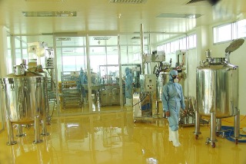
Technical data for a marketing authorisation (MA) and their role for assessment: Quality

Slide 9
Technical data for a MA and their role for assessment: Quality
Aim: to assess components, manufacturing, and final product so that product has appropriate quality to ensure safety and efficacy during entire lifecycle from production to end of shelf-life.
Quality is essential element for assessment of products;
Quality has to be assessed for each product anew;
“Vulnerable” to changes in processes:
Variations during life of product;
Potential quality defects.
Hazards/risks of inadequate quality: e.g. impurities, degradation products, non-compatibility of components: may have consequences on safety and/or efficacy

Slide 10
VICH guidelines available – Quality
GL 1: Validation of analytical procedures: definition and terminology
GL 2: Validation of analytical procedures : methodology
GLs 3, 4, 5, 8: Stability new active substances and products, dosage form, photostability, premixes
GLs 10, 11, 18: Impurities new active substances, products, residual solvents
GL 39: Test procedures and acceptance criteria for new active substances and products: Chemical Substances,
GL 40: Test procedures and acceptance criteria for new active substances and products: Biotechnological/Biological Veterinary Medicinal Products
GL 45: Bracketing and matrixing design
GL 51: Statistical evaluation of stability data

Slide 11
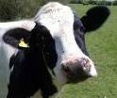
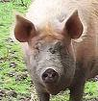
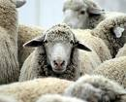
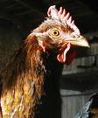
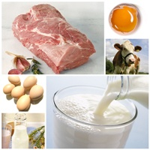
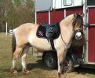
Role of data for assessment of a MA: Safety

Slide 12
Technical data for a MA and their role for assessment: Safety
Aim: to assess risk to
target animals;
for food producing animals safety to consumer of food derived from animals;
to human user of product and persons that come into contact (e.g. vet, farmer, animal owner, children hugging pet);
impact for the environment;
for antimicrobials: risk of resistance development.
For benefit – risk assessment.
Identify appropriate conditions of use; necessary risk mitigation measures / warnings in product literature.

Slide 13
Technical data for a MA and their role for assessment: Safety
Safety documentation - 15 VICH GLs:
Pharmacology (pharmacodynamics, pharmacokinetics)
Toxicology (Single dose toxicity, repeated dose toxicity (2x), reproductive toxicity incl. teratogenicity, genotoxicity, carcinogenicity, other) (GLs 22, 23, 28, 31, 32, 33)
Residue studies (Metabolism and residue kinetics, Pharmacokinetics, Depletion of residues, Analytical method) (GLs 46, 47, 48, 49)
Target animal safety (GL 43)
Safety of users
Environmental impact assessment (Phase I and Phase II) (GLs 6 & 38)
Antimicrobial safety (Microbiological ADI, Data to assess antimicrobial resistance) (GLs 27 & 36)

Slide 14
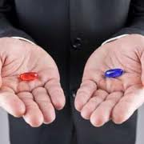
Technical data for a MA and their role for assessment: Efficacy

Slide 15
Technical data for a MA and their role for assessment: Efficacy
Aim: Establish efficacy, determine indications, dosage regimen, as well as special precautions of use for marketing authorisation

Slide 16
Technical data for a MA and their role for assessment: Efficacy
Pharmacology (partly same data as safety)
Pharmacodynamics: to study mechanisms underlying the therapeutic effect
Pharmacokinetics
Studies in target animals to establish effective dosage regimen
Bioavailability studies
Development of resistance (antimicrobials, antiparasitics)
Pre-clinical trials (might partly already be included in safety or residues data)
Dose determination
Results of clinical trials

Slide 17
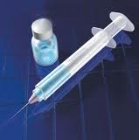
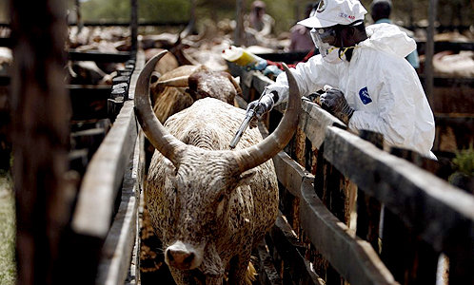
Biologicals (vaccines)

Slide 18
Technical data for a MA and their role for assessment: Biologicals (vaccines)
Principles, i.e. Quality, safety and efficacy, same as for pharmaceuticals
Specific studies often differ due to nature of product

Slide 19
VICH guidelines available – Examples Biologicals
GL 17: Stability Biotechnological/Biological Veterinary Medicinal Products
GL 25, 26: Testing of residual formaldehyde, residual moisture
GL 34: Test for the detection of Mycoplasma contamination
GL 40: Test procedures and acceptance criteria for new active substances and products: Biotechnological/Biological Veterinary Medicinal Products
GL 41: Examination of live vaccines in target animals for absence of reversion to virulence
GL 44: Target animal safety testing for veterinary live and inactivated vaccines
GL 50: Criteria to waive target animal batch safety testing for inactivated vaccines for veterinary use

Slide 20
What are VICH guidelines used for?
VICH harmonises which data are required for a marketing authorisation and how studies are conducted.
Harmonisation of requirements increases availability of medicines, reduces costs, and reduces animal testing through acceptance of same studies by all countries which accept VICH guidelines.
VICH guidelines cover large parts of a marketing authorisation dossier, in particular for pharmaceuticals.
VICH does not provide guidance on assessment of studies (exceptions: Environmental Impact Assessment (EIA), microbiological ADI).
VICH does not discuss assessment or decisions on marketing authorisations

Slide 21
How to use VICH guidelines (1/5)
VICH guidelines are publicly available through the VICH website. They are also published on the websites of the regulatory authorities of the VICH members and observers.
VICH member countries/regions are obliged to use the VICH guidelines.
The use of the VICH guidelines is not restricted to the VICH members and observers.
Any country or regional organisation can use these guidelines for the requirements for the authorisation of veterinary medicines in their country or region.

Slide 22
How to use VICH guidelines (2/5)
There are different ways on how technical guidelines such as VICH guidelines can be implemented:
Some countries use them as separate technical guidelines in support of legislation without making them part of legislation;
Other countries implement them as a regulation or piece of legislation.
It is the decision of the country or region and may depend on how the legislation in the country/region has been set up.

Slide 23
How to use VICH guidelines (3/5)
If a country/region considers implementing VICH guidelines, please bear in mind that it is not necessary to implement all the guidelines as a package, but a country/region may choose to implement only selected guidelines, e. g. the most needed or suitable guidelines, or may consider a stepwise implementation process.
The VICH member countries/regions have the obligation to implement the VICH guidelines as adopted and other countries are also encouraged to use VICH guidelines unchanged.

Slide 24
How to use VICH guidelines (4/5)
Some countries/regions that are not part of the VICH process may not be able to apply particular parts of a guideline due to specific local conditions,
e. g. climatic conditions, animal diseases or animal species relevant for that country/region.
In such a case, a VICH guideline can be implemented adapted, to the minimum extent necessary, to fit local conditions.

Slide 25
How to use VICH guidelines (5/5)
In the interest of promoting harmonisation of technical requirements for the registration of veterinary medicinal products, VICH would encourage the widest possible use of its guidelines, with the minimum changes only when absolutely necessary to adapt the guidelines to local conditions.
Feedback to VICH on which guidelines have been implemented in your region, and how they were implemented, would be greatly appreciated.

Slide 26
Thank you for your attention
Any questions

