Slide 1
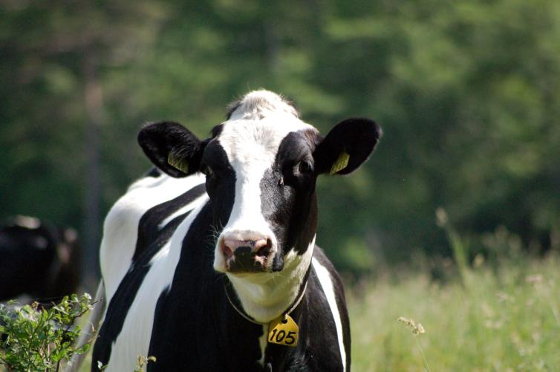
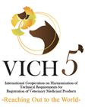
Trends in Research and Development of New Veterinary Drug Substances and Products
Mark J. Micallef, PhD
28th October, 2015

Slide 2
Introduction
Importance of new drugs in veterinary medicine
Companion animals
In many countries with aging populations, humans are increasingly seeking animal companionship and companion animals are now more likely to be considered as members of the family than they were previously.
Food-producing animals
According to the FAO, the world’s population will surpass 9 billion by the year 2050. A substantial part of the increased population will be relatively wealthy, and it is estimated that the annual meat production will need to almost double to 470 million tons to meet the demand.
Emerging diseases and One Health
Furthermore, increasing contact between animals and humans, intensification of rearing of food-producing animals and increased ease of international travel have resulted in increased incidences of emerging diseases and cross-infection between species.

Slide 3
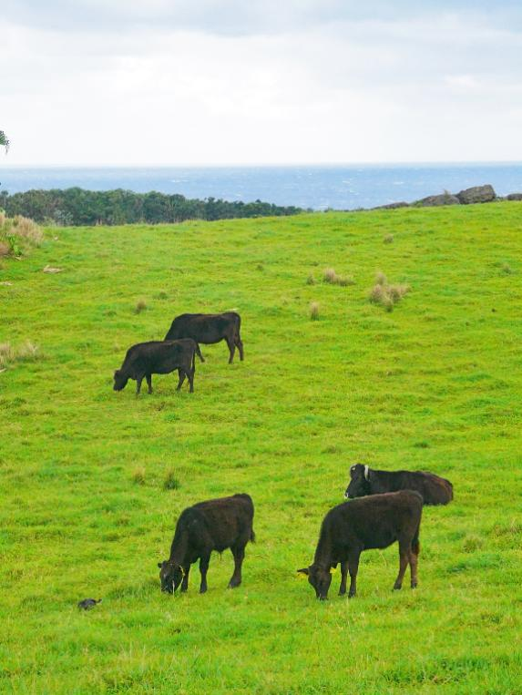
Established strategies of drug development in veterinary medicine
A common trend for the development of new veterinary medical products has been to apply human pharmaceuticals to veterinary usage. One problem with this is that formulations that work for human pharmaceuticals may not always work for animals. Therefore, novel drug delivery systems (DDS) are also being developed for ease of application in animals.

Slide 4
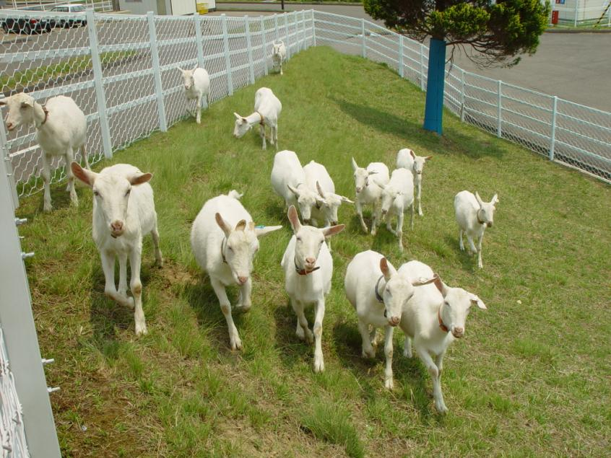
Drug Delivery Systems (DDS) in veterinary medicine
One obvious problem is the delivery of orally active drugs to ruminants. Drugs that bypass the rumen for absorption in the intestines are sometimes desirable. Alternatively, some drugs may be encapsulated in liposomes that may protect the drug from degrading enzymes. Transdermal administration of liposome-encapsulated drugs is also possible.

Slide 5
Drug Delivery Systems (DDS) in veterinary medicine
Based on observations that the folate receptor (FR) is widely expressed in human cancer, researchers at Purdue University in the United States examined expression of FR in canine cancers and developed a FR-targeting form of DDS for vinblastine. One of the problems with this system is the development of a reliable means to measure FR expression on canine cancers in vivo.

Slide 6
Special formulations
Practical applications of veterinary pharmaceuticals may require a degree of innovation for application in the field. For example, it may be difficult to maintain a cold chain in certain hot countries and new methods for the delivery of heat-sensitive pharmaceuticals need to be developed. Such innovative methods include effervescent tablets for Newcastle Disease vaccines in poultry and freeze-dried highly soluble spheres, also for poultry that may be dissolved for use in drinking water.

Slide 7
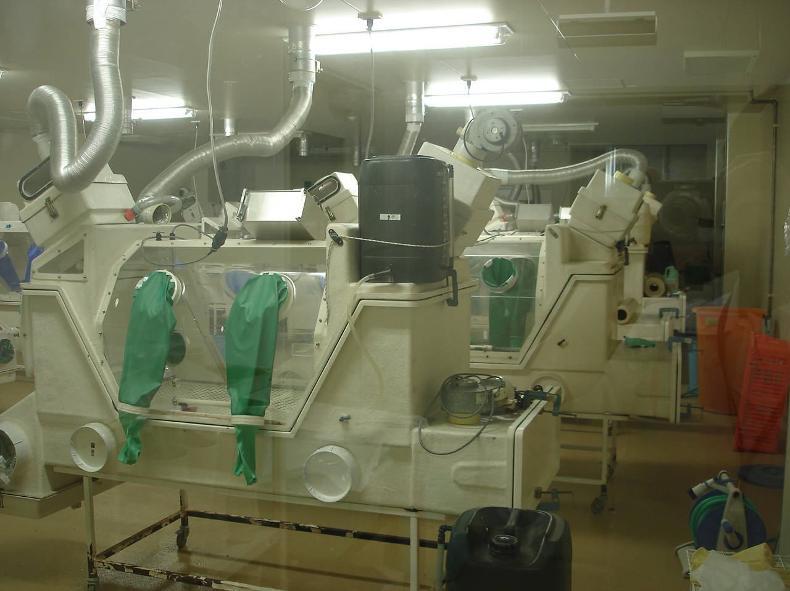
Multivalent vaccines
In both companion and food-producing animals, there is a tendency to treat with multivalent vaccines that protect against multiple pathogens. Based on this need, several multivalent recombinant virus vector vaccines have been developed for poultry. Viral vectors that express immunogenic antigens expressed by different pathogens can elicit immune responses to the target pathogens in one treatment cycle.

Slide 8
Campylobacter vaccines for poultry
Campylobacter infections remain a problem even in developed countries due to improperly cooked chicken. According to a research group at the University of Arizona, between 20 to 80% of broiler houses in the US are contaminated with Campylobacter jejuni. The group proceeded to produce a vaccine based expression of two Campylobacter proteins using an engineered live Salmonella typhimurium vaccine which is now being commercialized privately.

Slide 9
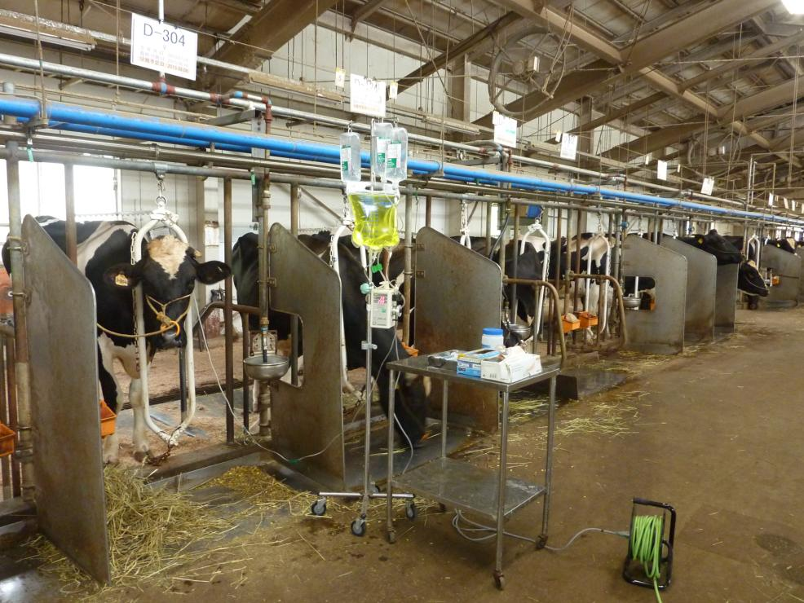
Alternatives to antibiotics
Resistance to antibiotics is a worldwide concern both in human and veterinary medicine. The concern of the possible emergence of superbugs able to decimate whole populations has led to proposals to restrict the non-therapeutic use of antibiotics in farm animals and also to find alternatives that do not carry the risk of the induction of resistance. For instance, bacteriophages and their products have been evaluated for application in both human and veterinary medicine.

Slide 10
Cancer treatment for companion and production animals
1. Conventional chemotherapies
Chemotherapeutic agents used in humans are also used in companion animals when surgery is not possible or insufficient. However, due to the severe side effects of chemotherapy, novel formulations meant to reduce side effects are being developed. A water-soluble paclitaxel which does not require Chremophor for solubility has been developed and has been granted a conditional license in the US for use in mammary carcinomas and squamous cell carcinomas. A similar product based on doxorubicin is also in development.

Slide 11
Cancer treatment for companion and production animals
2. Antibodies
Antibody products have revolutionized human therapy for cancer and inflammation, both because of efficacy but also because of the lower number of administrations when compared to conventional therapies. Rituximab is a blockbuster antibody product that is used in human B cell lymphoma and has benefitted numerous patients. In the US, an antibody therapy for CD20-expressing canine B cell lymphoma recently obtained full approval from the USDA. A similar antibody targeting CD52-expressing T lymphoma cells has also obtained a conditional license from the same agency.

Slide 12
Cancer treatment for companion and production animals
2. Antibodies (continued)
A group from the School of Veterinary Medicine at Hokkaido University, Japan, have produced an antibody against bovine programmed death-1 (PD-1), one of the immune checkpoints immportant in immune regulation and suppression of anti-self responses. The group is interested in developing a therapy for application in bovine leukemia.

Slide 13
Cancer treatment for companion and production animals
3. Cytokines
Cytokines such as interleukin 2 (IL-2) and interferon alpha (IFN-α) have long been used in certain countries for cancers considered to be susceptible to immune therapy such as renal carcinoma and melanoma. IL-2 is known to stimulate T cells and natural killer (NK) cells to kill tumor cells and a product based on a canarypox virus vector expressing feline IL-2 was approved for use in Europe and conditionally approved for use in the US in feline fibrosarcoma.

Slide 14
Cancer treatment for companion and production animals
4. Therapeutic vaccines
A DNA vaccine against human tyrosinase, an enzyme required in melanin synthesis, has been developed as a therapeutic vaccine for canine melanoma. One advantage of this vaccine is that it does not induce significant toxicity in the patients. The vaccine received full marketing approval from the USDA in 2010.

Slide 15
Cancer treatment for companion and production animals
5. Small molecule inhibitors
Our knowledge of normal and dysfunctional cellular pathways in mammalian cancer cells is based mostly on studies on murine and human cell lines. Mostly, we assume that canine and feline cancer cells behave in the same manner as murine and human cancer cells. In recent years, small molecule inhibitors of cellular proliferation pathways have been developed for human cancer. Some time ago, the first such inhibitor for canine cancer active against the c-kit pathway was approved by the FDA and by EMA for use in canine mast cell tumors.

Slide 16
Cancer treatment for companion and production animals
6. Oncolytic virotherapy
Oncolytic viruses are viruses that are either selectively able to infect and replicate in cancer cells or have been engineered to infect and replicate selectively in cancer cells. One such virus product is a Herpex simplex virus engineered to express human GM-CSF. This was recently approved for use in patients with melanoma by a FDA panel of experts based on Phase III clinical trial results. A number of oncolytic viruses have been examined both in vivo in dogs and in vitro on canine cancer cell lines by various research teams throughout the world.

Slide 17
Pain treatment for companion animals
Antibodies
Biotechnology now allows us to engineer cells to produce large amounts of therapeutic antibodies using large-scale mammalian cell culture. Protein expression systems can now produce desired proteins in gram levels per liter of culture medium. Furthermore, the ability to produce antibodies that are compatible with the species they are targeting via a patented process known as ‘petization’, results in antibodies with high safety profiles where the potential for the generation of anti-antibody is greatly reduced. Two such products are now being developed in the US targeting nerve growth factor in the treatment of pain in dogs and cats, respectively.

Slide 18
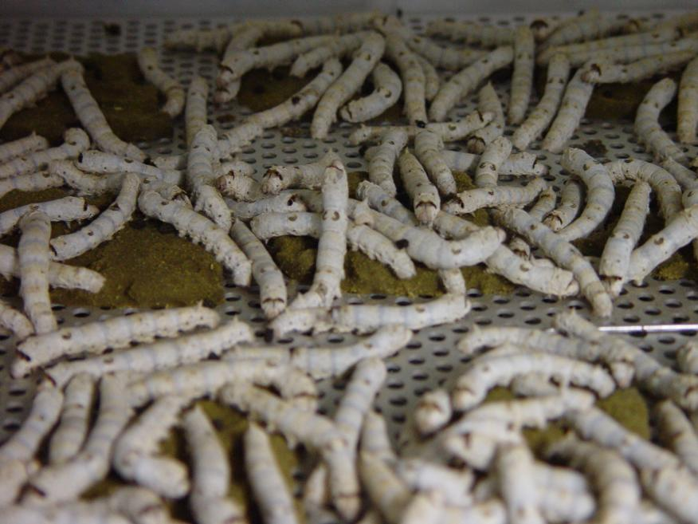
Other therapies for companion animals (continued)
In Japan, the Japanese Ministry of Agriculture, Forestry and Fisheries (JMAFF) granted marketing approval to a canine interferon α expressed in strawberries for the treatment of gingivitis in dogs in 2013. More recently, JMAFF approved an a house dust mite allergen-specific therapeutic for immunotherapy of house dust mite induced canine atopic dermatitis (cAD) the allergen of which is expressed in silkworms using a baculovirus vector.

Slide 19
Biotechnology in veterinary medicine
Many of the products described in previous slides are the result of advances in biotechnology. Despite the costs that many times accompany the development of novel biotechnological products, recombinant virus vector vaccines, recombinant proteins such as bioactive cytokines and immunotherapeutic allergens, therapeutic antibodies and oncolytic viruses are almost all the result of advances in biotechnology.

Slide 20
Biotechnology in veterinary medicine
The benefits of using biotechnological techniques for the development and manufacture of novel pharmaceuticals include:
Products with enhanced pharmaceutical properties such as long-term action, targeting of particular pathways, multiple antigen vaccines and species specificity.
The possibility of large-scale production and reduced costs, an important factor especially in livestock vaccination.

Slide 21
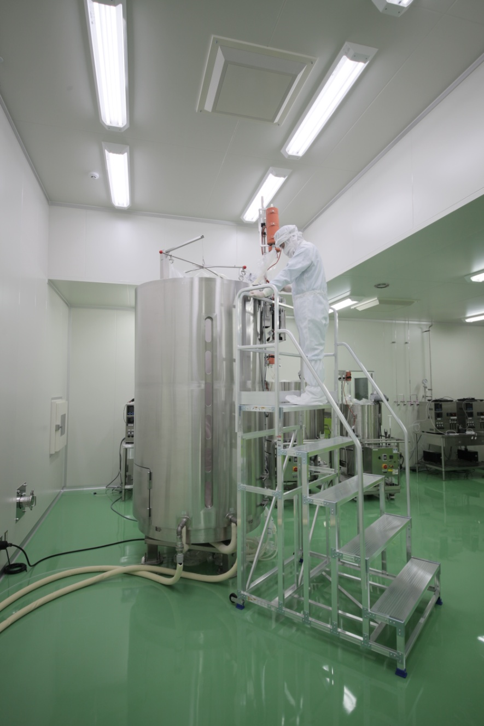
Biotechnology in veterinary medicine
For example, production of grams per liter of recombinant protein products in mammalian cell cultures is not unheard of in the industry.

Slide 22
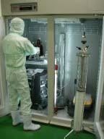
Biotechnology in veterinary medicine
The investments in time and manufacturing capacity made by industry in the pursuit of the development of state-of-the-art biotech pharmaceuticals is considerable. However, as innovation in the veterinary medical field is making important advancements in science, it is important that new developments are timely shared between educational bodies, regulatory agencies and industry.

Slide 23
Categorization of biotech products for veterinary use
Given the complexity of novel mechanisms of action of some recently developed biotech veterinary products, it may be difficult to categorize some of the newer products as either biologicals or pharmaceuticals. It may also be difficult to establish regulatory requirements for such products based on presently available guidelines. However, collaboration between stakeholders including regulatory agencies, will help to stimulate innovation that will eventually benefit all stakeholders.

Slide 24
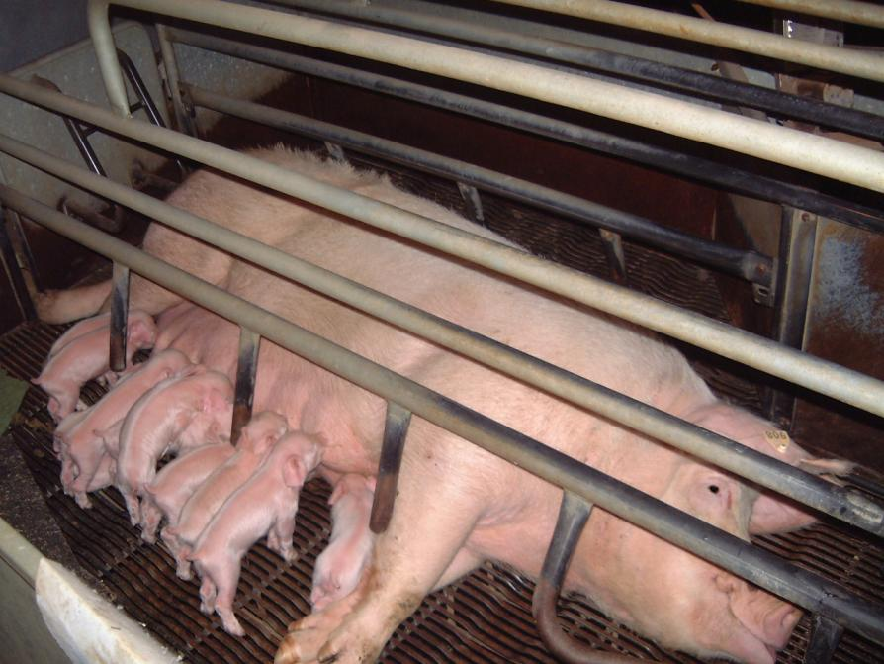
Thank you for your attention

