Slide 1
Challenges of Developing VICH Guidance for Residue Studies in Food Producing Aquatic Species
Session 7: VICH Conference
Tokyo, Japan: 27 – 29 October 2015
Pamela Boner, Zoetis

Slide 2
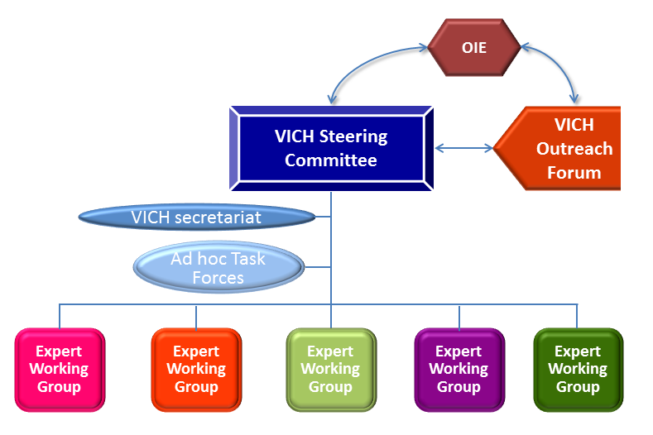
VICH Overview and How it Works
VICH publishes the draft guideline for public consultation through the support and network of the World Organization for Animal Health (OIE).
Countries that are not part of VICH are also invited to provide comments about each draft guideline
Notes:
How does VICH work?
Beginning with a VICH Steering Committee decision to pursue a new topic for which harmonized guidance is deemed necessary (based on a concept paper submitted by a VICH member), the VICH Steering Committee assigns the new topic to an Expert Working Group. That group then conducts face-to-face meetings, email exchanges and
teleconferences to develop a draft guideline.
After approval of the draft guideline by the Steering Committee, VICH publishes the draft for public consultation, typically for six months, through the public display processes of the member regulatory agencies and through the VICH website.
Through the support and network of the World Organization for Animal Health (OIE), countries that are not
part of VICH are also invited to provide comments about each draft guideline. After these public consultations, the draft returns to the Expert Working Group, which reviews the comments, finalizes the guideline appropriately and submits it to the Steering Committee for final approval.
The approved VICH guideline then becomes the official recommended guideline in the VICH member
countries, replacing previously existing national guidelines.
As of April 2011 VICH has completed 45 guidelines, and nine more are in process.
The VICH Steering Committee is also working towards providing a basis for wider international harmonization of registration requirements through a global outreach program.
The objective is to communicate the role of VICH, the benefits of harmonized registration requirements and facilitate the efficient use of resources in non-members of VICH. The aim is to provide
support, in close cooperation with OIE, for the governance of
veterinary medicinal products globally and to enable broad access
to high quality veterinary medicines for all livestock producers,
veterinarians, and pet owners in other parts of the world.
Steering committee is composed of 2 delegates of the regulatory authorities and 2 delgates representing industry from the three regions
Australia/NA, Canada and South Africa have observer status

Slide 3
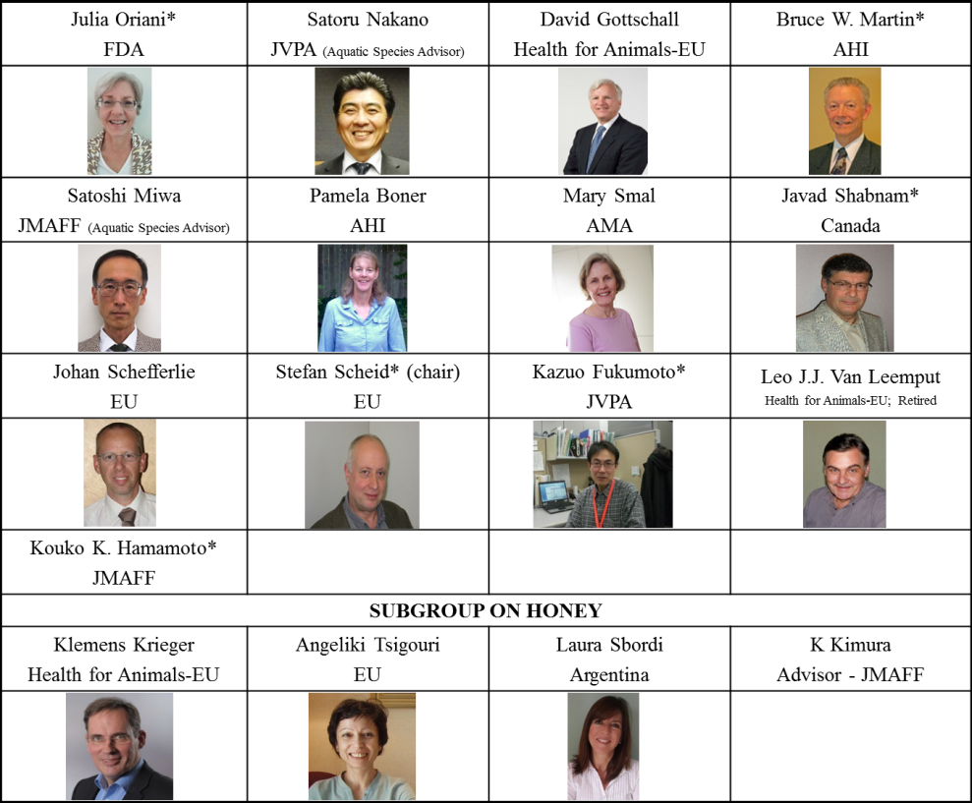
Metabolism and Residue Kinetics Expert Working Group Chairperson: Stefan Scheid (E.U)
Introduction
The Expert Working Group (EWG) on “Metabolism and Residue Kinetics” was founded at the 16th VICH Steering Committee meeting in May 2005 (Washington DC, USA)
* Also a member of the subgroup on honey
Notes:
Expert working groups are normally comprised of a minimum of 6 experts one representing each VICH full member. Each member may send one additional advisor to participate and the SC may depending on the expertise required allow for the appt of more than one expert per VICH member
Additional experts from observer countries or VICH outreach forum members may be appointed by the steering committee
A chairperson is appointed by the SC. The chairperson is responsible for initiating and guiding the work within the EWG
Observers may join in discussions and send experts to the EWG

Slide 4
Metabolism and Residue Kinetics Expert Working Group
Key Benefits of Harmonized Guidelines
Fewer residue studies will be needed which will result in lower costs for drug development, less animals sacrificed, more stream-lined drug approvals, and ultimately, greater human food safety to consumers.

Slide 5
Metabolism and Residue Kinetics Expert Working Group - Aquatics
Topic co-chairs: Pam Boner (Zoetis) Mary Smal (Elanco)
Edible Aquatic Species-decided to make a stand alone guidance. The inclusion of aquatic species was holding up GL48
Notes:
A number of issues of concern that may it problematic to include in GL 48.
GL 48 deals with terrestrial animals and we only look at 4 animals per time point. Those animals may be from a single source.
Introduce everyone to the importance of aquaculture

Slide 6
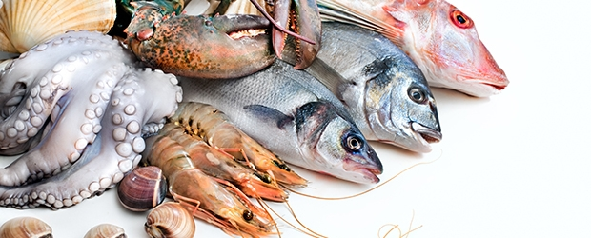
What are Aquatic Species?
Fish Finfish, Eel
Mollusks Snails, clams
Crustaceans Lobster, Shrimp
What terms should be used? shrimp vs prawns
Notes:
Fish, Mollusk , Crustaceans?
> 50 orders
Consideration of the economically important species
- Salt water, fresh water fish, anadromous species (salt and fresh water) and crustacean etc.
- About terms, in case of shrimps and prawns, refer the following sentence:
It is impossible to give a short definition of either name, as in different regions these terms are used for different animals or animal groups, and even within a single region the usage is not consistent... All in all the situation is quite confused, and nowhere a sharp distinction seems to be made between shrimps and prawns. In general one can say that the larger... species that are commercially most attractive are called shrimps in America, and prawns in most of the rest of the English-speaking world. The word shrimp being used almost everywhere for the... other small forms, but many exceptions occur here.

Slide 7
Aquatic Species Draft Guidance
This guidance addresses the recommendations on what should be provided for a marker residue depletion study design for aquatic species.
Metabolism studies based on VICH GL46, could be used in aquatic species to identify a marker residue for application of this guideline.

Slide 8
Aquatic Species Draft Guidance
Concept
Conducting a depletion study under worst-case conditions provides data for calculating the withdrawal period.
The guidance does not address how to calculate the withdrawal period
For example many regions recognize a withdrawal period based on the concept of degree days.
Notes:
The guidance does not address how to address the data.
Degree Days

Slide 9
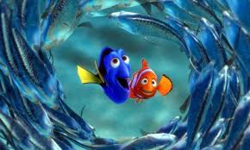
Fish Issues
Aquatic species is problematic due to more than 50 orders
Fresh vs Salt water
Notes:
A number of issues of concern that may it problematic to include in GL 48.
GL 48 deals with terrestrial animals and we only look at 4 animals per time point. Those animals may be from a single source.
Introduce everyone to the importance of aquaculture

Slide 10
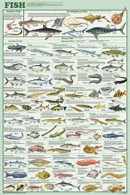
Fish Issues
Is extrapolation Across a Group Reasonable?
How should fish species be grouped?
Develop an approach to group the fish species –
Several approaches exist for these groupings:
Species physiology Drug delivery Culture system Economic importance Human food safety concerns
Notes:
A number of issues of concern that may it problematic to include in GL 48.
GL 48 deals with terrestrial animals and we only look at 4 animals per time point. Those animals may be from a single source.
Introduce everyone to the importance of aquaculture

Slide 11
Aquatic Species Draft Guidance
Critical Study Design Parameters
Water temperature
Study should be conducted under conditions that would result in the worst case scenario for tissue residues
Low versus High Water Temperature
In feed
Immersion
The sponsor should demonstrate that the conditions of the study yield the worst case for tissue residues

Slide 12
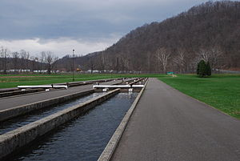
Aquatic Species Draft Guidance
Critical Study Design Parameters
Housing
Flow-through
Racks
Net pens
Recirculating water systems
Ponds
If more than one housing condition is used then the study should be conducted under conditions that would result in the worst case scenario for tissue residues
Selection for the appropriate scenario of the final design parameters should be justified.

Slide 13
Aquatic Species Draft Guidance
Critical Study Design Parameters
Number of Fish in the Study
Terrestrial animals 4 per time point
Larger numbers needed for fish due to variability

Slide 14
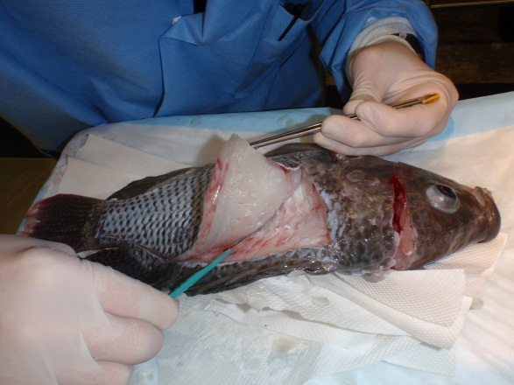
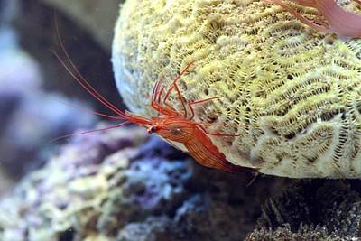
Aquatic Species Draft Guidance
Critical Study Design Parameters
How to define edible portion
Edible: How to discriminate edible and inedible?
Organs of fish and crustacean are generally eaten in most of the Asian countries, except fin, scale, and bone.
Instead of the term 'edible,' should the terms be meat, shell, and organ?

Slide 15
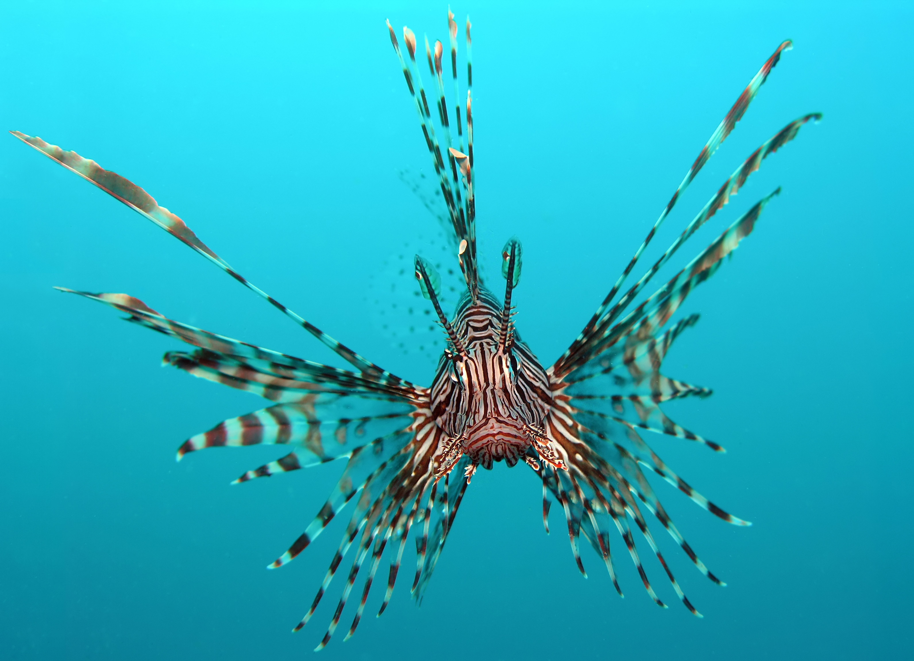
Acknowledgements
Residue and Kinetics EWG
Aquatic Species Guidance Co-chair Mary Smal Advisors: Julia Oriani Satoshi Miwa Satoru Nakano
Thank You
Questions?

