Slide 1
How to use the pharmacovigilance (PhV) guidelines (GLs)
August 2018

Slide 2
Disclaimer
These slides have been provided for training purposes only. The presenter has made every attempt to ensure that they are consistent with relevant VICH guideline(s).
As always, the original Guideline(s) should be used as the primary source of information for working with regulators.

Slide 3
Contents
Re-cap – VICH presentation on ‘Development of a PhV system’ (also available on the VICH website)
What are the VICH PhV guidelines
How to use the VICH PhV guidelines
Common questions

Slide 4
Access to the PhV presentations
"Pharmacovigilance: Development of PhV systems and processes"

Slide 5
Recap
Contents
Goals of PhV
Different levels of PhV systems
Development of a PhV system
Implementation of a PhV system
Putting PhV requirements in legislation
Planning a system – authorities
Responsibilities of the authorities
Encouraging reporting and raising awareness
Filing an adverse event report (AER)
Practical approach to adverse event reports
Practical approach to periodic summary/update reports
Scope of PhV
Minimum requirements for an adverse event report

Slide 6
Why align with international standards
Saves resources – no need to re-invent the wheel
Saves resources – standardised company systems
no need for companies to redesign systems for individual regions/countries,
or duplicate aggregate reports in different formats and timelines (International Birth Date)
Share, exchange and pool data; using the same language
Enhances PhV and public health
Long term vision – a single global PhV database
Efficiency
Leverage

Slide 7
What are the VICH Pharmacovigilance guidelines?

Slide 8
VICH Pharmacovigilance guidelines
Pharmacovigilance of veterinary medicinal products:
GL24 - Management of Adverse Event Reports (AERs)
GL29 - Management of Periodic Summary Update Reports
GL30 - Controlled list of terms
GL35 - Electronic Standards for Transfer of Data
Plus: Step By Step Document of what to do
GL42 - Data Elements for Submission of Adverse Events Reports
5 guidelines

Slide 9
VICH Pharmacovigilance guidelines
Pharmacovigilance of veterinary medicinal products:
GL24 - Management of Adverse Event Reports (AERs)
GL29 - Management of Periodic Summary Update Reports (PSUR)
2 Managerial guidelines
Purpose: to harmonise basic pharmacovigilance concepts useful in developing reporting systems to collect and act on spontaneous adverse event reports

Slide 10
VICH Pharmacovigilance guidelines
Pharmacovigilance of veterinary medicinal products:
GL30 - Controlled list of terms
GL35 - Electronic Standards for Transfer of Data
Plus: Step By Step Document of what to do
GL42 - Data Elements for Submission of Adverse Events Reports
3 Technical guidelines
Purpose: to create common standards for electronic information exchange to allow information exchange between authorities, with industry and with the public

Slide 11
VICH Pharmacovigilance guidelines
GL24 - Management of adverse event reports (AERs)
Definition of the scope of pharmacovigilance
the management of the detection and investigation of the clinical effects
Definitions of terms
The Pharmacovigilance Process – the flow of information
Veterinary Medicinal Product Adverse Event Serious Adverse Event Unexpected Adverse Event | Adverse Event Report Periodic Summary Update International Birth Date
Notes:
The scope of pharmacovigilance in this VICH document is defined as the management of the detection and investigation of the clinical effects of marketed VMPs mainly concerned with the safety and efficacy in animals and the safety in people exposed to these products. While pharmacovigilance in its broadest sense may entail a wide range of activities, this document only deals with the spontaneous reporting system for the identification of possible adverse events following the use of marketed VMPs.

Slide 12
VICH Pharmacovigilance guidelines
GL24 - Management of adverse event reports (AERs)
Definitions of terms
Adverse Event Report
An adverse event report is a direct communication from an identifiable first-hand reporter (see IV.7) that includes at least the following information:
an identifiable reporter
an identifiable animal(s) or human(s)
an identifiable VMP
one or more adverse events
One animal or one human being, or a medically appropriate group exhibiting similar clinical signs should be included in a single report.
Notes:
The scope of pharmacovigilance in this VICH document is defined as the management of the detection and investigation of the clinical effects of marketed VMPs mainly concerned with the safety and efficacy in animals and the safety in people exposed to these products. While pharmacovigilance in its broadest sense may entail a wide range of activities, this document only deals with the spontaneous reporting system for the identification of possible adverse events following the use of marketed VMPs.

Slide 13
VICH Pharmacovigilance guidelines
GL24 - Management of adverse event reports (AERs)
The Pharmacovigilance Process – info flow
Notes:
The scope of pharmacovigilance in this VICH document is defined as the management of the detection and investigation of the clinical effects of marketed VMPs mainly concerned with the safety and efficacy in animals and the safety in people exposed to these products. While pharmacovigilance in its broadest sense may entail a wide range of activities, this document only deals with the spontaneous reporting system for the identification of possible adverse events following the use of marketed VMPs.

Slide 14
VICH Pharmacovigilance guidelines
GL29 - Management of Periodic Summary Update Reports (PSUR)
Timing of reporting
International Birth Date
Frequency of reporting – risk-based approach
Contents of reports

Slide 15
VICH Pharmacovigilance guidelines
GL30 - Controlled list of terms
Predefined terms that must be used when submitting data elements in electronic AE reports (as described in GL42)
Important for consistency, for coding data and sharing data; allows standardised input and analysis
Maintenance procedure
180 page document

Slide 16
VICH Pharmacovigilance guidelines
GL35 - Electronic Standards for Transfer of Data
Need to exchange data quickly and easily between Regulatory Authorities and MAHs on a worldwide level
Standards to construct a single electronic message to transmit AE report contents to all VICH regions
Recommendation to ensure secure transmission
Definition of the electronic message structure
Relationships (cardinality) between the data elements
Establishment of additional vocabularies for electronic transmission (GL24 definitions, GL30 terms, and GL42 data fields in the AE report)
Business and schema validation rules and field descriptors specification for the data
Step By Step Document of what to do

Slide 17
VICH Pharmacovigilance guidelines
GL42 - Data Elements for Submission of AE Reports
Standardises the data for submission in AE Reports
Consistent set of data = harmonised approach for the detection and investigation of adverse effects
Format and Description of Data Elements
Administrative and Identification Information
Description of the AE

Slide 18
How do I use the VICH guidelines?

Slide 19
How – using the GLs
Establish legal framework
Use the 2 managerial GLs (24 & 29) as references to form the regulatory framework
GL24: scope, definitions, process for adverse event reporting
GL29: timing and process for periodic summary update reporting
Establish documentation
AE reporting form (refer to GL42 for data elements to be included in the form)
Establish a database
Can be in Excel or Access – keep it simple
Refer to GL 30 for standardised list of terms (international alignment!)
TIP: create a list of code numbers from GL30 in your database, and alongside each put the term in your local language

Slide 20
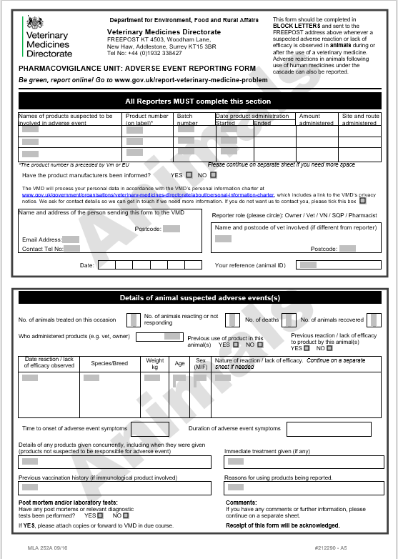
Examples of adverse event reporting forms
VMD (shown here)
Good example of a single page form
EMA (see link)
Good example with all EU language versions
http://www.ema.europa.eu/ema/index.jsp?curl=pages/regulation/document_listing/document_listing_000176.jsp&mid=WC0b01ac058002ddcb
FDA (next slide)
Good example of the use of drop down lists

Slide 21
Adverse event reporting form
FDA example
https://www.fda.gov/downloads/AboutFDA/ReportsManualsForms/Forms/UCM527320.pdf
subsets VICH guideline GL30 are incorporated into “drop down” lists for end users (example: species and breed lists)
this PREVENTS misspellings (e.g. “Rockweiler”) and other typos and really helps when working with or evaluating the data.

Slide 22
Common questions

Slide 23
Common questions
Where can I find an example of a standard reporting form?
What is the international birthdate concept?
How do I encourage farmers and vets to report adverse events?
Who can send reports, and to whom?
Should reporting an AE be a legal requirement?
What periodicity is used in the EU for periodic safety update reports?
A deadline of 15 days to report a serious AE – isn’t that too late?
How do I do trend analysis?
Is an Excel spreadsheet sufficient?
How do you establish if the product is at fault or the AE was caused by something else? How do I perform causality scoring?

Slide 24
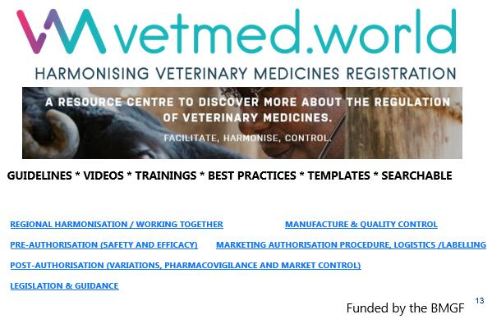
Common questions
Where can I find an example of a standard reporting form?
UK
https://www.gov.uk/government/organisations/veterinary-medicines-directorate
EMA
http://www.ema.europa.eu/ema/index.jsp?curl=pages/regulation/document_listing/document_listing_000176.jsp&mid=WC0b01ac058002ddcb
FDA
https://www.fda.gov/downloads/AboutFDA/ReportsManualsForms/Forms/UCM527320.pdf

Slide 25
Common questions
What is the international birthdate concept (IBD)?
A harmonised date for the submission of PhV periodic safety reports
Products are authorised in different countries at different times
To avoid the need for a MAH to produce a continual flow of partially over-lapping reports for different countries (duplication of effort)
When the product safety profile is already established and the same/similar product is authorized in a new country - no need from a safety point of view to start new aggregate report cycles.
See GL 29: Management of Periodic Summary Update Reports

Slide 26
Common questions
How do I encourage farmers and vets to report adverse events?
Make it easy
Make reporting forms easily available
Make reporting forms quick and easy to fill in
Communicate and educate
Communicate the system and the need and benefits
Workshops, conferences, seminars
Add to training programmes
Provide feedback
Send letter of receipt
Publish an annual report on adverse events received and actions taken

Slide 27
Common questions
Who can send reports, and to whom?
FEEDBACK
………………………………………..

Slide 28
Common questions
Should reporting an AE be a legal requirement for consumers/veterinarians?
Preferred: professional duty, vet training and education
Legislation: can ‘strongly encourage’, but not a legal offence
Carrot and not stick
Make it easy to report
Communicate the benefits
Provide feedback

Slide 29
Common questions
What periodicity is used for periodic summary update reports (PSURs) with aggregate analyses?
In the EU*
Years 1 and 2: every 6 months
Years 3 and 4: every year
Year 5 onwards: every 3 years
In the USA
Years 1 and 2: every 6 months
Year 3 onwards: every year
*N.B. PSURs are removed from the new EU legislation, becoming applicable in 2022, and are replaced by ‘signal detection procedures’ within a single EU database

Slide 30
Common questions
A deadline of 15 days to report a serious AE – isn’t that too late?
Time may be needed to collect missing data to complete the AE report before submission
(a) MAHs usually notify authorities immediately
(b) 15 day deadline to submit full report to authorities
*N.B. the timing for expedited reports is not addressed in VICH guidelines. Exact legal requirements vary depending on the region. However the general principles for defining expedited reports are described in VICH GL24

Slide 31
Common questions
How do I do trend analysis?
Consider number of AE reports received vs your resources
Decide periodicity of review; use a risk-based approach
EXCEL may be sufficient depending on the number of reports.
Basic approach
Record number of reports per product or same active ingredient and same formulation, per species
Detection of any change in the serious/non-serious ratio over time,
Monitor for new, unexpected clinical signs reported as well as unusual changes in reporting frequency of signs over time
Identification of potential issues should be followed by a case series assessment for signs/reports of interest (can include causality assessment and may also be helpful in identifying/evaluating any potential risk factors)
Notes:
This will likely depend on the product and the number of ADEs received for the product, but I suppose there are some general concepts to consider. For products that receive a low number of ADEs, if resources are available to do individual case review, that would likely remain the gold standard. Specifically to analysis involving trending, generally there is some periodicity to review (sometimes this is risk based: e.g., semi-annually for newer products and annually for older products). Data from ADE reports can be aggregated, and clinical sign frequencies monitored (reviewers typically start at the preferred term level in VeDDRA) to look for increases in frequency of reporting, or identify serious/severe medical events. If data mining is available that can also be used as a supplemental source of information to look for emerging safety issues that are being reported disproportionately – data mining typically identifies the less common issues that may need to be investigated. The latter is an emerging field for VMPs.

Slide 32
Common questions
Is an Excel spreadsheet sufficient?
Yes, to start with…
Depends on the number of reports
Depends on ambitions for data analysis, data mining/disproportionality analysis.

Slide 33
Common questions
How do I perform causality scoring?
General Principles to Consider:
Association in time or anatomical sites
Presence or absence of a more likely cause (e.g., concomitant medication or underlying disease)
Pharmacological explanation (pharm/tox profile) or previous knowledge of the product
Does the sign disappear when drug is withdrawn? Does the sign reappear if drug is re-administered?
Quality of the data (mainly completeness)
Causality scoring algorithms can be used to assess either at
The clinical sign level e.g. modified-Kramer system (used by FDA)
The case level e.g. ABON system (used by EU)
Train safety reviewers – consistency is important
Outcome – classification: probable, possible, unlikely, or unknown
Notes:
It is important to note that rarely, if ever, can causality be definitely determined with spontaneously reported ADE data. There are no internationally agreed upon standards/algorithms or criteria for assessing causality in individual cases. “Reportability” of an event does not depend on an assessment of causality. From a practical standpoint for reviewers who conduct causality assessments: there are several causality scoring algorithms that could potentially be used to assess either at the clinical sign level or at the case level (I think ABON is used in the EU on a case level, and modified-Kramer is currently being used at FDA CVM at the “sign” level, and there are several others in use by other regulatory authorities!) Whatever algorithm is use, it is most important to train safety reviewers on consistent use of the algorithms. Typically these algorithms rely on evaluation of temporal relationships, dechallenge/rechallenge information if available, association of the event with (or lack of association with) underlying disease, presence or absence of a more likely cause, and biologic plausibility. They are helpful in classifying uncertainly in a semi-quantitative way; however, they cannot prove or disprove causality nor give an accurate measurement of the likelihood of a relationship. The result of this type of assessment is signs/cases being classified into categories of associations that may include: probable, possible, unlikely, or unknown.

