Slide 1
VICH/IN/17/034
Draft 4
15 June 18
Bioequivalence Blood Level Study
Training provided for VICH GL 52:
BIOEQUIVALENCE: BLOOD LEVEL BIOEQUIVALENCE STUDY

Slide 2
Disclaimer
These slides have been provided for training purposes only. The presenter has made every attempt to ensure that they are consistent with relevant VICH guideline(s).
As always, the original Guideline(s) should be used as the primary source of information for working with regulators.

Slide 3
Agenda
What is bioequivalence (BE)?
Factors/variables that need to be considered when developing blood level BE study designs
Information that should be included in a blood level BE study report
Related topics not covered in this guideline:
Biowaivers
BE for “special types” of veterinary products (biomass products, therapeutic proteins or peptides, medicated premixes,…)
Other types of equivalence studies (pharmacological endpoint BE or clinical endpoint BE studies, in vitro dissolution tests,…)
Human food safety
Products where blood concentrations may not be indicative of drug levels at site of action, such as topically active formulations, intramammary products, or….
The potential need for supportive studies, such as palatability or licking studies (e.g. transdermal products, medicated blocks).
Animal species from which multiple blood sampling is difficult (e.g., fish, bees)

Slide 4
VICH GL52 vs other guidelines:
As appropriate, local guidance documents should be followed for addressing topics that are outside the scope of this BE guideline.
The glossary of GL 52 provides a definition of the various terms used in this guideline and provides some synonymous terms that may be applied in guidelines available in local jurisdictions.
Other relevant VICH guidelines should be consulted, such as GL 1 and 2 on the validation of analytical methods.

Slide 5
What is Bioequivalence (BE)?
The absence of a difference (within predefined acceptance criteria) in the bioavailability of the active pharmaceutical ingredient (API) or its metabolite(s) at the site of action when administered at the same molar dose under similar conditions in an appropriately designed study.
The rate and extent of drug absorption is typically estimated on the basis of drug concentrations in the blood
typically measured in plasma or serum
in GL52, the terms blood, plasma and serum are used interchangeably
So, plasma (or blood) concentrations are used as a surrogate to demonstrate BE between products
The assumption is that if two products are BE on the basis of comparative blood concentration versus time profiles, their safety profiles and effects at the site of actions will be likewise be indistinguishable.

Slide 6
What is Bioequivalence (BE)?
Blood level BE is established on the basis of predefined acceptance criteria:
Peak drug concentration (Cmax) and area under the curve (AUC) are considered to reflect respectively the rate and extent of absorption of the active pharmaceutical ingredient.
For demonstration of bioequivalence, the 90% confidence interval for the ratio of the population means (test product/reference product) for the parameter (Cmax or AUC) should fall within pre-defined limits
This comparison in terms of mean ratios is based upon the use of Ln-transformed data (discussed later in this presentation)
For most systemically absorbed drug products, the 90% confidence interval about the mean ratio of test and reference product Cmax or AUC values should be contained within the limits of 0.80-1.25.
These limits are defined statistically at a 90% level of confidence (α = 0.05 per tail).
Assumption: if 2 products are bioequivalent:
The products are therapeutically “indistinguishable”,
they will have the same safety and efficacy characterisitics (given no difference in toxicity of excipients) and they are interchangeable in a clinical setting

Slide 7
Blood level study
Gives the most sensitive and accurate measure of the rate and extent of absorption of the drugs.
Therefore, this is the preferred study type to demonstrate product BE and should be used whenever whole blood/plasma/serum concentrations of the drug can be measured in the test animals
Assumes that formulation differences affect only the rate and extent of drug absorption and that all other pharmacokinetic (e.g., drug clearance and distribution) and dynamic factors are formulation-independent.

Slide 8
In this training…
In-vivo blood level bioequivalence study only
Specifics on what should be considered during protocol development and when generating the final study report

Slide 9
Focus
In vivo protocol development
Product selection
Dose selection
Route of administration
Study design
Subject and species selection
Prandial state
Exclusion of data from analysis
Sample size determination
Blood sampling schedule
Blood level parameters (in accordance with guideline)
Defining the analyte
Bioanalytical method validation
Statistical analysis

Slide 10
1. Product selection

Slide 11
What is a Reference product?
The drug product to which the in vivo bioequivalence of the “test” product is compared.
For a generic test product: an approved “originator” veterinary product, approved via a full application
For a modification of an innovator product: the reference formulation of the approved 'originator' to which the test formulation is compared.
The reference product must be from a veterinary medicinal product batch approved for the region or country where test product approval is being sought

Slide 12
Requirements for a test product?
Same API (active pharmaceutical ingredient) as reference product
Content assay from test & reference ≤5% difference
Representative of the final formulation of the product to be marketed
From a batch of >1/10 of production scale
In vitro characterization (such as dissolution testing and specifications of test product critical quality attributes) should be established for the test batch used in the BE study

Slide 13
In the study report we expect…
For the reference product
For the test product
product name,
strength (nominal and assayed content),
dosage form,
batch number,
expiry date (where available),
composition (quantitative and qualitative),
batch size,
manufacturing date
country of purchase

Slide 14
2. Dose selection

Slide 15
Which dose should we use?
Highest labeled (approved) dose of reference (typically as mg/kg) for test and reference
To account for potential changes in relative exposure due to the presence of saturable elimination processes
if linear PK across the entire dose range, any approved dose may be used if a scientific justification is provided as to why the highest dose cannot be used
No dose normalizing for content assay differences observed unless no reference batch which differs less than 5% from the test product can be found (see slide 51)
Content assay of test vs reference API must be within ±5% of label
In crossover studies, the impact of this variation is essentially eliminated by the within-subject comparison of the bioavailability
Notes:
NOTE: Caveat : for rapidly growing animals where large weight changes are anticipated (e.g., studies conducted in rapidly growing animals where there is a risk of differences in drug absorption, distribution, metabolism, or elimination in period 1 vs 2 that could bias the within-subject comparison) the use of dose adjustments will need to be considered on a case-by-case basis.

Slide 16
Which dose should we use?
When could a higher dose (up to 3x) be acceptable? Only if:
linear PK (across the whole range if there is a dose range)
needed to be able to measure blood levels
absence of saturable absorption processes (which could camouflage differences at the approved (lower) dose)
Dose to be rounded up
for solid oral dosage forms to the next available strength
oral dosage forms not to be manipulated
breaking along score lines only if data confirm content uniformity of the halves of the split scored test and reference products
or to the next division of the dosing equipment
When conducting a cross-over study, each subject is administered the same mg/kg dose in periods 1 and 2.

Slide 17
Dose selection if non-linear PK
In reference products with less than proportional increase in AUC with an increase in dose (non-linear kinetics) across the therapeutic range, the following should be considered:
Saturable absorption processes:
potential to be BE at highest labeled doses but not at lowest, which may warrant testing for product BE at the lowest labeled dose.
Saturable in vivo dissolution due to API solubility constraints
In this case, there may be the need to test for in vivo BE at highest dose and at the lowest dose (or a dose in the linear range) to account for the impact of the surface to volume ratio of the tablets

Slide 18
3. Route of administration

Slide 19
Route of administration
Typically, the same route and site of administration should be used for the test and reference products.
Separate studies for each route of administration approved for the reference product

Slide 20
4. Study design

Slide 21
Cross over or parallel design ?
Test
Ref
Cross over
Ref
Test
Enrollment
Treatment
Wash Out
Treatment
Test
Parallel
Ref

Slide 22
Cross-over vs parallel design
Parallel study design
Each subject is administered only one treatment, resulting in a product BE assessment based upon a between-individual comparison.
Intersubject variability + intrasubject variability + random error contribute to the uncertainty associated with the (population) prediction of mean test/reference ratios
Cross-over study design
Each subject is administered both the test and reference formulations, resulting in a product BE assessment based upon a within-individual comparison.
Intersubject variability does not contribute to the uncertainty associated with the (population) predictions of mean test/reference ratios
 | Test period
Group 1 | Test
Group 2 | Reference
 | Sequence A | Sequence B
Period 1 | Test | Reference
Period 2 | Reference | Test

Slide 23
Preferred study design: crossover
Classic in vivo BE study: two-period, two-sequence, two-treatment crossover study to reduce the magnitude of residual (unexplained) study variability:
- Source of between subject differences
drug permeability
gastrointestinal transit time
first pass metabolism
drug clearance
volume of drug distribution
Washout interval required between periods to ensure the absence of a physiological or pharmacological carryover effect:
wash-out should ideally be ≥ 5x blood terminal elimination half-life
to prevent the presence of residual drug concentratons that can bias calculation of PK parameters (AUC, Cmax and Tmax) in subsequent periods
if API is an endogenous substances: demonstrate that pre-dose baseline concentrations for period 1 and 2 are comparable

Slide 24
When is parallel design preferred?
When there is the risk of a physiological carryover (e.g., hepatic enzyme induction) that would influence systemic concentrations of the treatment administered in period 2.
When the time needed to insure the absence of a physiological and/or pharmacological carryover effect is not feasible because:
Wash-out time period would be extremely long, due to a very long (terminal elimination) half-life.
Wash-out required would cause significant physiological changes in growing test animals
Extended release formulations where the drug release continues for a duration of months to years.
When the target species has insufficient blood volume to allow for a two-period study.

Slide 25
Other alternative study designs:
Replicate study design: alternative to crossover
- When used?
When a classic cross over design would require too many animals
When the reference product is known to be associated with “high” within-individual pharmacokinetic variability
When applying reference scaled in vivo BE approach (in jurisdictions where this is permitted)
- Using three or four periods within each group
3 periods = “partial replication”
the reference OR the test is replicated in all subjects
4 periods = “full replication”
each subject receives the test and reference products twice
Specific order of treatments to be designed carefully

Slide 26
Other alternative study designs:
Sequential study design
Two step study, second phase only done when BE not yet demonstrated with the initial number of animals in phase 1
A priori criteria established in protocol before study initiation
In general, before using alternative design and corresponding method of statistical analysis: contact local/regional regulatory authorities!

Slide 27
Single dose or multiple dose design?
Single dose is standard
- For both immediate and modified release formulations
- More sensitive in assessing differences in release API from formulation into systemic circulation
Single and multiple dose studies can be performed using either crossover or parallel designs
Sequential or replicate designs not recommended for multiple dose studies (as very long duration might cause complications)

Slide 28
Single dose or multiple dose design?
When multiple dosing?
Extended release formulation intended for repeated dosing if there is accumulation between dosing (at least twofold increase in concentration at steady state compared to single dose)
C_{trough} to be investigated next to C_{max} and AUC
C_{trough} may differ from C_{min} if product has a lag time between administration and absorption
Saturable elimination processes that may lead to an under-estimation of product exposure differences when dosed at steady state.
Assay not sensitive enough to allow calculation AUC after single dose

Slide 29
5. Species and subjects

Slide 30
Subject and Species
Bioequivalence studies required in each (major) target species
Minor species extrapolation to be justified
Anatomy and physiology
Properties of API and formulation
Healthy animals, randomly assigned to groups
Representative of population
Homogenous and equally sized, uniform groups
Age, body weight, gender, nutrition, physiological state, sometimes also production level
Most pertinent in parallel study design as in cross-over animals serve as their own control
Drug free period before first dosing,
Preferably naive animals, but always drug free period long enough to ensure
no detectable residues,
no impact of potential physiological carry-over effects
Describe all in report!
And of course in protocol before initiation of the study

Slide 31
6. Prandial state

Slide 32
Prandial state
For orally administered drugs
Prandial state must be consistent with animal welfare and the kinetics of the API
Normally fasted, except for ruminants
Cats & dogs
normally fasted >8 hrs pre- and >4 hrs post-dose
but if label of reference product says only administration in fed state, the BE study should be performed in the fed state
For oral modified release in non-ruminants, use both fasted and fed conditions, unless adequately justified
Describe and justify rationale for fasted/fed conditions in protocol (before initiation of the study) and study report!

Slide 33
7. Exclusion of data/animals from study

Slide 34
Exclusion of data from analysis
Removal of all or part of an animal’s data?
always to be justified in report
always before actual analysis of blood samples is done !
If foreseeable: stipulate in protocol!
Classic case: if vomiting expected; always specify a priori in protocol
Define acceptable time between administration and vomiting
Define allowable amount of dose lost in vomitus
Define criteria for re-dosing a priori
Use all available data in analysis
If exclusion only happened in period 2, data from period 1 should still be included in the analysis
Because confidence intervals are generated on the basis of a within-subject treatment comparison, subjects with data generated solely in one period will not affect the final confidence intervals about the treatment means as produced by the study statistical analysis.

Slide 35
8. Sample size

Slide 36
Sample size (1)
“Minimum animal numbers” based upon estimates in pilot studies
estimated ratio of treatment means
within subject variability of reference product for crossover studies
between subject variability of reference product for parallel investigations
risk of animals “lost” during the study (e.g. dead, injury, vomiting)
should be justified a priori in the study protocol
Always estimate sample size for PK parameter
for which the greatest within (crossover study) or between (parallel study) variability is expected.
for which you expect the largest difference between the treatment estimates

Slide 37
Sample size (2)
International “minimum” size of evaluable treatment group : N≥12
- So for 2 period - 2 sequence – 2 treatment crossover:
two groups for each sequence (A-B and B-A)
minimal 6 animals per sequence, or in total minimum 12 animals in the study
- So for parallel design
Only one group per treatment
So minimal 12 animals in each group, and thus minimum 24 animals in the study

Slide 38
9. Blood sampling schedule

Slide 39
Blood sampling schedule
No less than 80% of AUC_{0-∞} should be covered by AUC_{0-last}
Frequent sampling around T_{max} to estimate C_{max}
make sure first sample is before C_{max}
- Duration of sampling
at least 3 samples in terminal log-linear phase, to estimate the terminal elimination rate constant (k_{e}) and AUC_{0-∞}
must cover ≥ 80% of AUC_{0-∞}
For immediate release dosage forms with long terminal elimination half-life, less than 80% of AUC_{0-∞} could be covered if sampling schedule covers C_{max} and the complete absorption phase
For multiple dose studies, to allow accurate AUC assessment
- Pre-dose sample must be collected immediately before dosing and
- Last sample as close as possible to end of dosing interval
- Show that steady state conditions are reached
For endogenous substances
- Pre-dose sample consistent with method of baseline correction

Slide 40
10. Blood level BE parameters

Slide 41
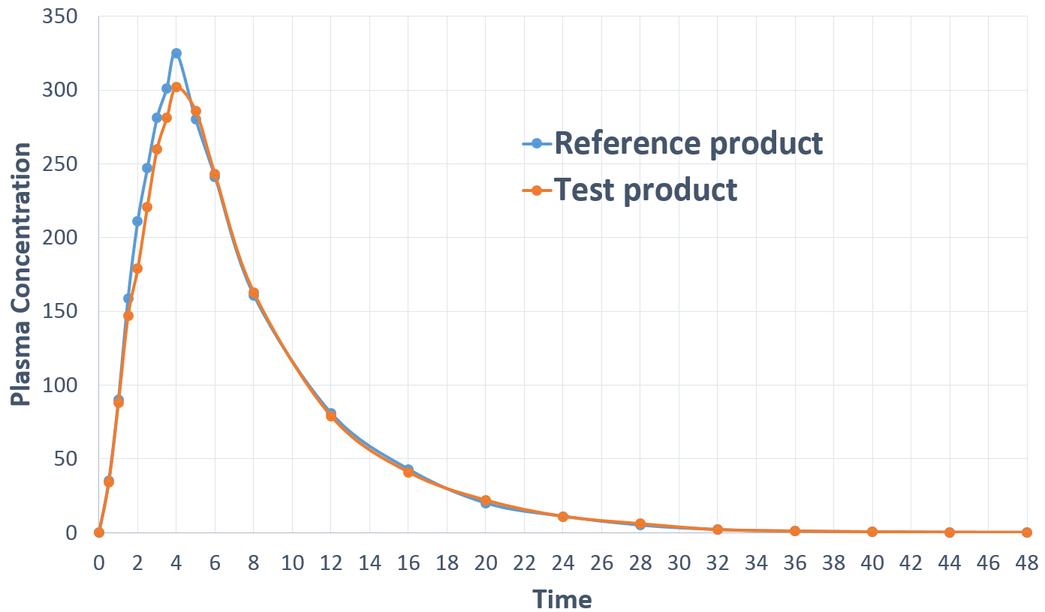
Blood level study
Cmax
Cmax
Tmax
Tmax

Slide 42
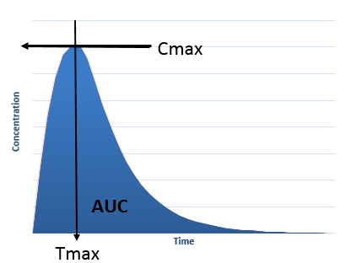
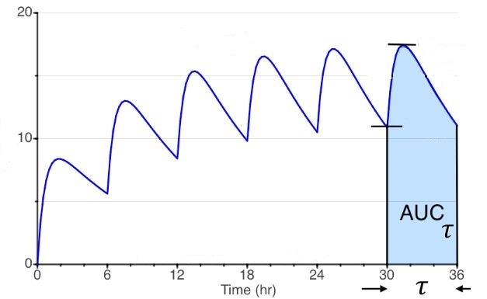
Blood level studies: single / multiple dose
Single dose
Multiple dose
where AUCτ is the AUC estimated over a complete dosing interval at steady state.
In that case, steady state AUCτ = AUC_{0-inf} after a single dose if the absorption and elimination processes are concentration-independent.
Notes:
Showing Cmax and Tmax and AUCτ in single dose or multiple dose administration

Slide 43
Blood Level BE Parameters
In single dose studies
- C_{max}, T_{max}, AUC_{0-Last}, and AUC_{0-∞} should be determined.
- terminal elimination half-life (k_{e} ) and T_{lag} may be relevant
In multiple dose studies the following should be determined
- AUC_{τ}
- steady state C_{max} values (C_{max ss}),
- steady state C_{trough} values (C_{trough} _{ss})
- steady state T_{max} values (T_{max} _{ss})
If endogenous substance: correct for baseline levels using method defined in protocol a priori.
- Recommendation:
Estimate pre-dose levels at the same time on 3 consecutive days
Substract that mean endogenous baseline from quantified concentrations at each sampling time
Use non-compartmental methods to determine PK parameters
- Describe methods used in report

Slide 44
11. Define the analyte

Slide 45
What is the analyte
Parent compound (classic):
- usually C_{max} _{parent} more sensitive to difference in absorption rates
- total concentrations (sum of protein-bound and free concentrations)
If the administered compound is a pro-drug with negligible blood concentrations:
- test for active metabolite (formed after absorption)
- justify the metabolite measured
If drug with enantiomers: need enantiomer (chiral)-specific analysis IF
- enantiomers have different PK profiles AND
- the AUC ratio of the enantiomers is modified by a difference in their respective absorption rates AND
- enantiomers have different pharmacodynamic profiles
Possibly need for stereospecific analytical method
- if test or reference product contains chiral excipient that selectively can alter absorption of one or both of the enantiomers
- if drug is a single enantiomer that undergoes in vivo chiral conversion

Slide 46
12. Bioanalytical method validation

Slide 47
Bioanalytical method validation
Appropriate validation of the bioanalytical method is required (see also other relevant VICH GLs 1 and 2)
Report must contain following aspects of performance and validation of the method
- Concentration range and linearity
- Matrix effects
- Limit of quantitation (LOQ, lower and higher)
- Specificity (selectivity)
- Accuracy
- Precision
- Stability of analyte and internal standard

Slide 48
Bioanalytical method validation
The following data from quality control (QC) samples obtained during in-phase analytical runs containing incurred samples should be provided:
- Precision
- Accuracy
Contact regulatory authorities beforehand if there might be a need to include incurred sample reanalysis (IRS) as a component of the method validation
- IRS is the repeat analysis of a subset of subject samples in separate analytical runs

Slide 49
13. Statistical analysis

Slide 50
Statistical model
The ANOVA (Analysis of Variance) takes into account sources of variation that can have an effect on the response variables
For crossover studies:
The statistical model typically accounts for the variation due to sequence, animal-nested-in-sequence, period and treatment, removing intersubject variability from the “residual error” term.
The residual error is the variation that remains undefined.
This residual error contains both intra-individual variability plus the unexplained variability.
It is the residual error that is used in the estimation of the width of the confidence interval
For parallel design studies:
Treatments typically compared using a one-way ANOVA
So the residual error contains intrasubject, intersubject variability and random error.

Slide 51
Ln-Transformation
Should be used for BE evaluation
Distribution of AUC and C_{max} is typically log-normal rather than normal. Therefore, analysis is conducted on a log-normal scale.
When evaluating Ln-transformed treatment effects, treatment comparisons are based upon the difference in Ln-transformed treatment values. Upon back-transformation (returning values to an arithmetic scale) of these differences (exponentiation of differences), the comparison is then expressed in terms of ratios (i.e., exp (Ln A – Ln B) = A/B).

Slide 52
Dose normalisation
In a crossover study, dose normalization is only considered if there are very large differences in animal weights over the course of the study
In rare instances involving parallel study and when the drugs are administered on a mg rather than on a mg/kg basis, between-animal differences in body weight could inflate the magnitude of the residual error to an extent that a prohibitively large increase in subject numbers would be necessary to maintain study power.
In such situations, discuss with the regulatory authorities the acceptability of dose normalization and the corresponding method of data analysis a priori during protocol development.
In exceptional cases where a batch of reference product with an assay content differing less than 5% from the test product cannot be found, the data could be dose normalized.
In such cases, the procedure for dose normalization should be pre-specified and justified by inclusion of the results from the assay of the test and reference products in the protocol.

Slide 53
Confidence interval acceptance criteria
To declare two products bioequivalent (and to be internationally acceptable), acceptance criteria for AUC and C_{max} (in multiple dose studies also C_{trough}) should be 0.80 to 1.25
So after Ln transformation and back transformation, for the parameters considered, the upper confidence interval limit should fall below 1.25 and the lower confidence interval limit should fall above 0.80 in order to accept that the test and reference products are bioequivalent.
Statistical BE evaluation is best generated using 90% confidence intervals, i.e. the two one-sided confidence interval approach for the ratio of the population geometric means (test/reference) for the parameters under consideration
Definition of confidence interval-“If an investigator repeatedly calculates these intervals from many independent and random samples, 90% of these intervals would correctly bracket the true population ratio”

Slide 54
Minimum content of stats report
At a minimum, the study report should include
the individual subject concentration versus time data for each study period (indicating period and treatment associated with each blood level profile),
subject allocation to sequence,
individual parameter estimates,
methods used for parameter estimation,
summary statistics,
and the statistical output (e.g., ANOVA).
This would enable regulatory authorities to perform PK and statistical analyses if necessary.

Slide 55
Glossary 1
Acceptance criteria (syn: confidence bounds): The upper and lower limits (boundary) of the 90% confidence interval that is used to define product BE.
Active pharmaceutical ingredient (API) (syn: active substance): A substance used in a finished pharmaceutical product, intended to furnish pharmacological activity or to otherwise have direct effects in the diagnosis, cure, mitigation, treatment or prevention of disease or to have direct effect in restoring, correcting or modifying physiological functions of the body.
Area under the curve (AUC): Area under the plasma drug concentration versus time curve, which serves as a measure of drug exposure. It includes several different types of AUC estimates:
AUC_{0-Last}: AUC to the last blood sampling time associated with quantifiable drug concentrations. The last quantifiable concentration (the limit of quantification, LOQ) is determined by the sensitivity of the analytical method. The last quantifiable drug concentration may occur prior to the last blood sampling time.
AUC_{0-∞}: AUC_{0-Last} with the addition of the extrapolated area from the last quantifiable drug concentration to time infinity. The terminal area from the last quantifiable drug concentration to time infinity is estimated as C_{last/}λe, where Clast is the last quantifiable drug concentration and λe is the terminal slope of the Ln concentration-time profile.
AUC_{tau} (AUC_{τ}): AUC over one steady state dosing interval. Mathematically, the quantity equals AUC_{0-∞} of the first dose if there is linear (non-saturable) PK.
Assay content: The amount of the analyte in a sample

Slide 56
Glossary 2
Bioavailability: The rate and extent to which the API or active metabolites enters the systemic circulation.
Bioequivalence: The absence of a difference (within predefined acceptance criteria) in the bioavailability of the API or its metabolite(s) at the site of action when administered at the same molar dose under similar conditions in an appropriately designed study.
Biomass: Crude products of fermentation, where the fermentation derived product is not extracted or purified; rather the resulting fermentation mixture, including the API and fermentation broth, is dried and used as is in the manufacture of medicated feeds or feed additives.
Biowaiver: A waiver of the requirement to demonstrate in vivo BE between a test and reference drug product.
Blood: Within this guidance, the terms blood, plasma, and serum are used interchangeably.
Composition: The ingredients as well as the absolute amounts of these ingredients included in the formulation.
C_{max}: The maximum (or peak) concentration of API or its metabolite(s) in blood.
C_{min}: The minimum concentration of the API or its metabolites in the blood at steady state. In the absence of a measurable delay between drug administration and the first appearance of drug in the systemic circulation C_{min} equals C_{trough}.
C_{trough}: The concentration of API or its metabolite(s) in blood at steady state immediately prior to the administration of a next dose.
Dosage form (syn: pharmaceutical form): The physical form of a dose of a medication such as tablet, capsule, paste, solution, suspension, etc.
Drug product (syn: medicinal product): A finished dosage form that contains the API usually in association with one or more excipients.

Slide 57
Glossary 3
Elimination rate constant (k_{e}): The first-order rate constant describing drug elimination from the body. Although the amount of drug eliminated in a first-order process changes proportionally with concentration, the fraction of a drug eliminated remains constant. The elimination rate constant is, then, a fraction of a drug that is removed from the body per unit of time.
Enantiomer: a pair of chiral isomers (stereoisomers) that are direct, nonsuperimposable mirror images of each other. Enantiospecificity in pharmacokinetics can arise because of enantioselectivity in one or more of the processes of drug absorption, distribution, metabolism and excretion.
Excipient (syn: inactive ingredient): A substance other than the API that has been appropriately evaluated for safety and is included in a drug product to either aid in its manufacturing; protect, support or enhance stability, bioavailability, or target animal acceptability; assist in product identification; or enhance any other attribute of the overall safety and effectiveness of the drug product during storage or use.
Extended release formulation: A dosage form that is deliberately modified to protract the release rate of the API compared to that observed for an immediate release dosage form. This term is synonymous with prolonged or sustained release dosage forms.
Finished dosage form: A dosage form of the API which is intended to be dispensed or administered to the animal and requires no further manufacturing or processing other than packaging and labelling.
Good Laboratory Practice (GLP): Quality standards for conducting non-clinical laboratory studies and field trials. Regional standards/regulations are specified by each regulatory jurisdiction
Highest labeled dose: The highest approved dose of the reference product as indicated on the label (usually defined as strength per unit body weight, e.g., mg/kg). If there is an approved dose range, the highest labeled dose would be the highest dose in that range.
Linear pharmacokinetics: When the concentration of the API or its metabolite(s) in the blood increases proportionally with the increasing dose, and the rate of elimination is proportional to the concentration, the drug is said to exhibit linear pharmacokinetics. The clearance and volume of distribution of these drugs are dose-independent.

Slide 58
Glossary 4
Modified release formulation: Drug products where the rate and/or place of release of the API(s) is different from that of an immediate release dosage form administered by the same route. This deliberate modification is achieved by a special formulation design and/or manufacturing method.
Medicated Premix: A veterinary medicinal product which has been granted marketing authorization and is intended for oral administration following its incorporation into animal feedstuffs. The medicated premix frequently consists of the API, a carrier, and a diluent.
Nonlinear pharmacokinetics: As opposed to linear pharmacokinetics, the concentration of the API or metabolites in the blood does not increase proportionally with the increasing dose. The clearance and volume of distribution of these may vary depending on the administered dose. Nonlinearity may be associated with any component of the absorption, distribution, and/or elimination processes.
Pharmacokinetics (PK): The study of the absorption, distribution, metabolism, and excretion of an API and/or its metabolite(s).
Reference product: The drug product to which the in vivo BE and, in some instances, the in vitro equivalence of the test drug product is compared.
Replicate study design: an investigation where at least one of the treatments is repeated.
Relative bioavailability: The bioavailability of a drug product when compared with another formulation of the same drug administered by an extravascular route.
Steady state (ss): The condition where the API input rate is in dynamic equilibrium with its output (elimination) rate.
Stereoisomer: compounds differing only in the spatial arrangement of their atoms.
Strength: The amount of API in a drug product expressed in specific unit of measurement (e.g., 10 mg/mL, 25 mg/tablet).
Test product: The drug product used for BE comparison to the reference product.
T_{lag}: The duration of time between drug administration and the appearance of the API in the systemic circulation.
T_{max}: Time to the C_{max}.
Transdermal product: A dosage form designed to be applied to intact skin for the purpose of delivering the API for absorption through the skin and into the systemic circulation.

