Slide 1
GL11 – Impurities: Guideline on Impurities in New Veterinary Medicinal Products

Slide 2
Disclaimer
These slides have been provided for training purposes only. The presenter has made every attempt to ensure that they are consistent with relevant VICH guideline(s).
As always, the original Guideline(s) should be used as the primary source of information for working with regulators.

Slide 3
Quality guidelines on impurities
GL 11 is one of the guidelines which belongs to the group of guidelines dealing with impurities:
GL10 (R) – Impurities in New Veterinary Drug Substances
GL11 (R) - Impurities in New Veterinary Medicinal Products
GL18 (R) – Impurities – Residual Solvents in New Veterinary Medicinal Products, Active Substance and Excipients

Slide 4
Table of contents
Introduction
Scope
Rationale for reporting and control of impurities
Analytical procedures
Reporting degradation product content of batches
Listing of degradation products in specifications
Qualification of degradation products
Decision Trees

Slide 5
Introduction
The objective of GL11 is to provide guidance for registration applications on the content and qualification of impurities in new veterinary medicinal drug products (VMP) produced from chemically synthesised new drug substances not previously registered in a region or member state.
Alternative approaches may be used.

Slide 6
Scope of GL11
Only those impurities in new VMP’s classified as degradation product of the drug substance or reaction products of the drug substance with an excipient and/or immediate container
Degradation product: An impurity resulting from a chemical change in the drug substance during manufacture and/or storage of the new VMP
Generally, impurities present in the new drug substance which are not also degradation products, should not be monitored in the new VMP.
This guideline does not apply to VMPs used during clinical research or development
Not in scope: impurities from excipients, extractables and leachables, biological products, peptides, oligonucleatides, radiopharmaceuticals, fermentation products and semi-synthetic products derived from fermentation, herbal products, crude products of animal or plant origin, extraneous contaminants, polymorphic forms and enantiomeric impurities.

Slide 7
Identification, reporting and qualification thresholds
Reporting threshold: A limit above (>) which a degradation product should be reported
Identification threshold: A limit above (>) which a degradation product should be identified
Qualification threshold: A limit above (>) which a degradation product should be qualified
Qualification: The process of acquiring and evaluating data that establishes the biological safety of an individual degradation products or a given degradation profile at the levels specified.

Slide 8
Identification, reporting and qualification thresholds
Identification threshold | 1,0%
Reporting threshold | 0,3%
Qualification threshold | 1,0%
Higher thresholds should be scientifically justified

Slide 9
Rationale for the reporting and control of degradation products
The applicant should summarize the degradation products observed during manufacture and/or stability studies of the new VMP.
Additionally, laboratory studies conducted to detect degradation products in new VMP should be summarized.
Summary should include test results of batches manufactured during development and batches representative of the proposed commercial process.
A rationale should be provided for exclusion of those impurities that are not degradation products (i.e. process impurities from the drug substance, impurities arising from excipients..)

Slide 10
Rationale for the reporting and control of degradation products (cont.)
Any degradation product observed in stability studies conducted at recommended storage condition should be identified when present at a level above the identification threshold (1,0%)
When identification is not feasible, a summary of the studies performed should be presented.
Degradation products at a level of not more than the identification threshold (1,0%) do not need to be identified.
However, analytical procedures should be developed for those degradation products that are suspected to be unusually potent, producing toxic or significant pharmacological effects at levels of not more than the identification threshold (1,0%)

Slide 11
Analytical procedures
Analytical procedures are validated and suitable for the detection and quantification of impurities (see VICH 1 and 2 Guidelines for Analytical Validation)
As appropriate, this validation should include samples stored under relevant stress conditions: light, heat, humidity, acid/base hydrolysis, and oxidation
The quantitation limit for the analytical procedure should be not more than (≤) the reporting threshold (0,3%)
Organic impurity levels can be measured by a variety of techniques, including those that compare an analytical response for an impurity to that of a reference standard or to the response of the new drug substance itself
Differences between analytical methods used during development and those proposed for registration should be discussed

Slide 12
Reporting degradation product content of batches
Analytical results should be provided in the registration application for all relevant batches of the new drug product used for clinical, safety, and stability testing, as well as batches that are representative of the proposed commercial process
Qualitative results should be presented numerically, and not in general terms such as “complies” or “meets limits”,…
Any degradation product above the level of the reporting threshold (0,3%) should be reported, as well as the total of the degradation products
Results should be reported to one decimal place and rounded using conventional rules
All degradation products above the reporting threshold (0,3%) should be summed and reported as total impurities

Slide 13
Listing of degradation products in specifications
The specification for a new drug product should include a list of degradation products expected to occur during manufacture and under recommended storage conditions.
The selection of degradation products in the new product VMP specifications should be based on the degradation products found in batches manufactured by the proposed commercial process.
A rationale for the inclusion or exclusion of degradation products in the specification should be presented and include a discussion of the impurity profiles observed in the safety and clinical development batches.
Those individual degradation products with specific acceptance criteria included in the new VMP specifications are referred to as “specified degradation products”.
Specified degradation products can be identified or unidentified.
Qualification: The process of acquiring and evaluating data that establishes the biological safety of an individual degradation products or a given degradation profile at the levels specified.

Slide 14
Listing of Degradation Products in Specifications (cont.)
Acceptance criteria should be established by taking into account the acceptance criteria in the drug substance, the qualified level, increase during stability studies, and the proposed shelf life and storage conditions of the new VMP.
Each acceptance criteria should be set no higher than the qualified level of the given degradation product.
Where there is no safety concern, degradation product acceptance criteria should be based on data generated from batches manufactured by the proposed commercial process, allowing sufficient latitude to deal with normal manufacturing and analytical variation and the stability characteristics of the new VMP.

Slide 15
Listing of Degradation Products in Specifications (Cont.)
In summary, the new veterinary medicinal product specifications should include, where applicable, the following list of degradation products.
Each specified identified degradation product
Should be included along with specified unidentified degradation products estimated to be present at a level above the identification threshold (1,0%)
Each specified unidentified degradation product
Should be referred to by an appropriate qualitative analytical descriptive label (e.g. “unidentified A”, unidentified with relative retention of 0,9”)
Any unspecified degradation with an acceptance criteria of not more than the identification threshold (1,0%)
Total degradation products
Sum of all degradation products at a level greater than the reporting threshold (0,3%)

Slide 16
Qualification of degradation products
Qualification is the process of acquiring and evaluating data that establishes the biological safety of an individual degradation product or a given degradation profile at the level(s) specified.
The applicant should provide a rationale for establishing degradation product acceptance criteria that includes safety considerations
The level of any degradation product present in a new VMP that has been adequately tested in safety and/or clinical studies would be considered qualified.
Degradation products that are also significant metabolites in animal and/or human studies are generally considered qualified.
Degradation products could be considered qualified at levels higher than those administered in safety studies based on a comparison between actual doses given in the safety study and the intended dose of the new VMP.

Slide 17
Qualification of degradation products
If the qualification threshold (1,0%) is exceeded and data are unavailable to qualify the proposed acceptance criteria of a degradation product, additional studies to obtain such data can be appropriate.
Higher or lower thresholds for qualification of degradation products can be appropriate for some individual new veterinary medicinal products based on scientific rationale and level of concern.
Proposals for alternative thresholds would be considered on a case-by-case basis.
In some cases, reducing the level of degradation product to not more than the threshold can be simpler than providing safety data.
Alternatively, adequate data may be could available in the scientific literature to qualify a degradation product.
Safety testing can be conducted on the new VMP or substance containing the degradation products to be controlled.

Slide 18
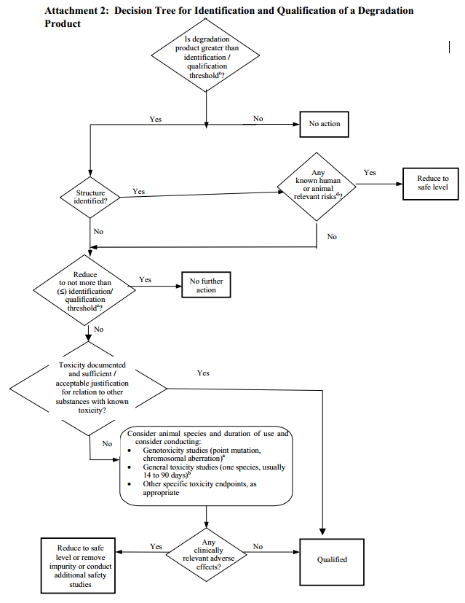
Decision tree

