Slide 1
VICH Pharmacovigilance Guidelines
Development and Harmonization
VICH5 November 29, 2015
VICH Electronic Standards Implementation
Margarita Brown, DVM MS, Chair
FDA Center for Veterinary Medicine
Notes:
VICH = International Cooperation on Harmonisation of Technical Requirements for Registration of Veterinary Medicinal Products

Slide 2
VICH Pharmacovigilance GLs
GL24 – Management of Adverse Event Reports
GL29 – Management of Periodic Summary Update Reports
Note: The EU legislation and FDA CVM regulations are currently under revision, including pharmacovigilance requirements referenced in the above two Management GLs
GL42 – Data elements for Submission of AEs
GL30 - Controlled Lists of Terms
GL35 – Electronic Standards for Transfer of Data
Notes:
GL = guideline, AE = Adverse event, EU = European Union, FDA CVM = Food and Drug Administration Center for Veterinary Medicine

Slide 3
Historical Progression
Management GLs
GL24 – signed October 2005, 2007
GL29 – signed June 2006
Technical GLs – FDA CVM focus for implementation
GL42 – signed October 2005, June 2010
GL30 – signed October 2007, June 2010
GL35 – signed February 2013
One technical document (Validation Procedures) for regional signature still pending

Slide 4
FDA CVM Reference Documents
Regulations
Regulation 21 CFR 514.3 - Definitions
Regulation 21 CFR 514.80 - Records and reports concerning experience with approved new animal drugs
Implemented Guidance for Industry (GFI)
GFI#188 – VICH GL42 – Data Elements for Submission (2010)
GFI#143 – VICH GL30 – Controlled Lists of Terms(2010)
GFI#214 – VICH GL35 – Electronic Standards for Transfer of Data
Notes:
CFR = Code of Federal Regulations, GFI = Guidance For Industry

Slide 5
Considerations for Harmonization Standardized Message Format
Provide electronic standards to consider a single message to transmit GL 42 content to all regions
Free and available to all users
Decision – must be in line with ISO 27953-1 Health informatics – pharmacovigilance – individual case safety reports
Health Level 7 (HL7) Individual Case Safety Report version 3 (ICSR) following ICH commitment
Notes:
ISO = International Organization for Standardization

Slide 6
Technical Requirements
Practical understanding of the technical issues and Guidelines is an essential component for a successful implementation
Each regional industry and Regulatory Authority participant will appoint at least one dedicated business expert and one dedicated technical expert
Each region should ensure adequate ISO/HL7 expertise and its application to veterinary AERs and knowledge of VICH pharmacovigilance guidelines of its expert(s)
Notes:
AER = adverse event report

Slide 7
Anticipated Issues
Unique descriptive wrappers will be needed to allow information to be accepted by regionally different IT systems
Implementation and interpretation of technical documents, including ISO 27953-1
Implementation of various Guidelines, such as reporting on domestic and foreign reports
Notes:
IT = information technology

Slide 8
Anticipated Issues
Specific needs for regional business rule validations such as:
computerized validation of regional application numbers and registration identifiers
formatting differences of telephone numbers
validation of states, counties, and provinces
dictionary list choices vs. text fields
confusion in identification of third party reports
Differences in time zones – how to accept a report that is submitted “tomorrow”??

Slide 9
Considerations for Harmonization Scope
Design to allow inclusion of required data
EMA – drugs and biologics
Japan MAFF – drugs and biologics
FDA CVM – drugs and product problems
USDA CVB – biologics
Canada VDD – drugs
Canada CCVB - biologics
Notes:
EMA = European Medicines Agency; MAFF = Ministry of Agriculture, Forestry and Fisheries; USDA CVB = United States Dept. of Agriculture Center for Veterinary Biologics; VDD = Veterinary Drugs Directorate; CCVB = Canadian Center for Veterinary Biologics

Slide 10
Harmonized Vocabularies
Use a common language for submission
It can be mapped to another language for display in the individual backend system
Separate Task Force was appointed to develop the vocabularies

Slide 11
Harmonized Vocabularies
Veterinary Dictionary for Drug Related Affairs
(VeDDRA) terminology for documenting clinical signs
System Organ Class (SOC)
High Level Term (HLT)
Preferred Term (PT)
Low Level Term (LLT)
Low Level Terms (LLT) are submitted.
VeDDRA hierarchy allows collection of reported LLT into a higher category (PT) on searches

Slide 12
Preferred Term: Lethargy
Could be reported as several different Low Level Terms:
Decreased activity
Depression
Devitalisation
Dull
Fatigue
Feelings of weakness
Generalized weakness
Lack of awareness
Lack of Response to owner
Lethargy
Listless
Loss of strength
Reluctant to move
Tiredness

Slide 13
GL 35 Electronic Standards for Transfer of Data
Scope
Recommendation to ensure secure transmission
Definition of electronic message structure
Relationships between the data elements
Establishment of additional vocabularies
Business and schema validation rules and field descriptors specifications for AER data and wrapper information

Slide 14
GL35 Problems Encountered
Monthly 3 hour teleconferences for 10 months
One face-to-face meeting to finalize
Email and break-out teleconferences as needed
Very complex material
Very difficult on participants
Not all could attend the physical meeting
Additional physical meetings could have facilitated understanding and progress

Slide 15
GL35 Problems Encountered
Contractors hired to create the technical format and documents
Very tight scheduling and timeline required
Process not common to all participants
Extra pressure due to need for strict adherence to schedule or extra costs incurred
Cost approximately $2.5 million for revision of existing implementation (does not include cost of FDA employees)

Slide 16
Electronic Implementation
First electronic implementation – May 2010
GL42 data elements in HL7 format
GL30 vocabularies
Second electronic implementation - June 2013
GL42 revisions from June 2010
Dose Denominator
Linked Case #s
Number of animals/term
CVM Internal Terms
GL35 international harmonization

Slide 17
First year of implementation 2011-2012

Slide 18
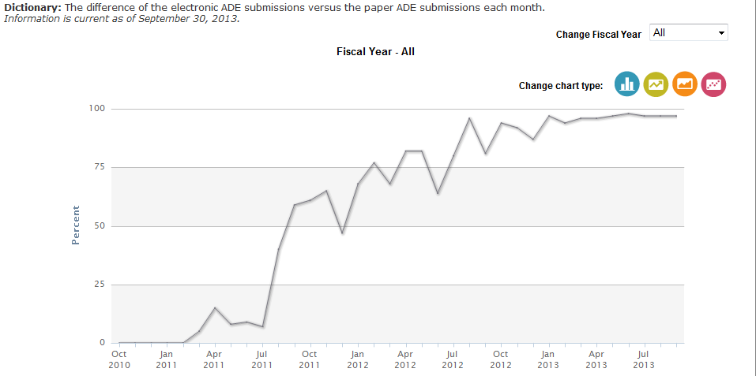
Percentage of electronic ADE submissions http://www.accessdata.fda.gov/FDATrack/track?program=cvm&id=CVM-OSC-Percentage-electronic-ADE-submissions
Notes:
ADE = adverse drug event

Slide 19
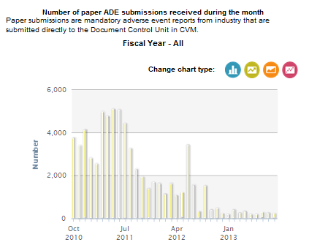

Slide 20
Number of Companies Reporting Electronically (May 2010 Implementation)
5 through Electronic Gateway

Slide 21
Number of Companies Reporting Electronically (June 2013 Revision)
16 through Safety Reporting Portal
6 directly through Electronic Gateway
5 testing – implementation at end of 2015

Slide 22
Advantages of Electronic Reporting Implementation
Workflow
Periodic cases in real time
Case quality
Closer working relationship with PV partners
Data available for rapid recovery
Data available for data mining and statistics
Notes:
PV = pharmacovigilance

Slide 23
Quality Assurance Review Sample (Program began October 1, 2013)
Goals:
Standardized, impartial review of electronically submitted cases and VeDDRA coding
Maximize receipt of complete and usable case information
Identify knowledge gaps (such as coding) for evaluation
Address gaps in future workshops or revisions

Slide 24
2015 ESI EWG Discussions
Welcomed new Observer – South Africa
First teleconference September 14, 2015
Resume maintenance of GL30 lists
Circulate each region’s priorities for discussion

Slide 25
Needed Technical Revisions
GL42 needs revision to include additional fields identified during development of GL35:
Add a field to identify MAH Product
Add a field to identify non-MAH Product
Add a field to identify biologics from drugs
Add additional fields to capture regional needs for identifying products in a Global Dictionary
Notes:
MAH = marketing authorization holder

Slide 26
Needed Technical Revisions
GL42 revisions suggested by industry users:
Add field for Reason for Use
Replace vocabulary list used for Length of Time from Exposure to Onset with integer and time unit field
Add field for Length of Time from Exposure to Onset to each VeDDRA Term
Add field for Site of Response

Slide 27
Possible Technical Revisions
Develop a harmonized xml message acknowledgement
Discuss the use of a single message for the needs of the different regions, rather than requiring a separate message for each region
Examples include:
Product problems
Environmental issues
Pesticides
Notes:
Xml = extended markup language

Slide 28
Possible Managerial Revisions
GL24 revisions under consideration:
Scope of PV Reports
Does this need expansion to include other regulatory responsibilities, such as pesticides and environmental issues?
Definitions of serious and expectedness
Might these criteria be redefined or discarded?
Timeline for submitting reports
Could alternative timelines be considered that would encompass all adverse event reports?

Slide 29
Possible Managerial Revisions
GL29 revisions under consideration:
New EU legislation – will the Periodic Safety Update be retained?
If not, should other regions require it?
If not, who is responsible for surveillance?

Slide 30
Further Considerations
Work towards a global product dictionary
FDA is working with the European Union (EU) to implement the ISO Identification of human Medicinal Products (IDMP) standards
These standards define, characterize, and identify each regulated Medicinal Product for human use
Might the Veterinary Medicinal Products be included in the future?
Might the VMPs of other VICH regions also be included?
Notes:
VMP = Veterinary Medicinal Product

Slide 31
Outreach Forum Considerations
Many countries are now entering the field of VMP regulation
Different languages, regulations, needs
How to consolidate reporting requirements
Is there the possibility of working together to establish a global repository for general reference?

Slide 32
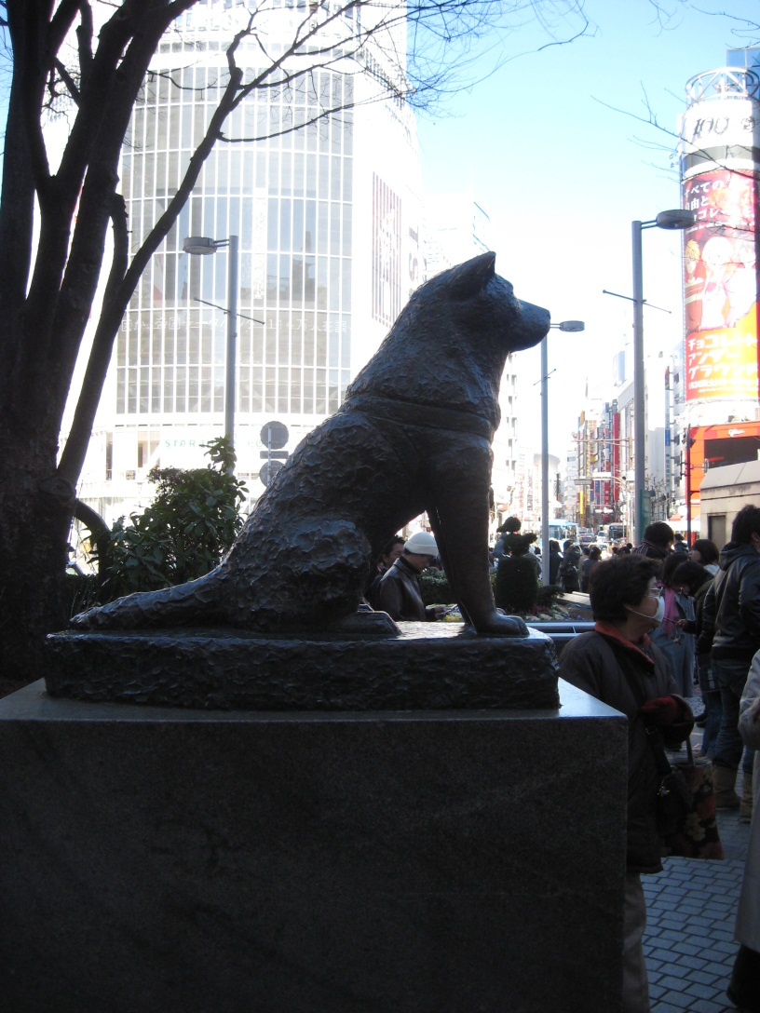
Thank You For Your Interest!

