Slide 1
GL18 (R) – Impurities: Residual Solvents in New Veterinary Medicinal Products, Active Substance and Excipients

Slide 2
Disclaimer
These slides have been provided for training purposes only. The presenter has made every attempt to ensure that they are consistent with relevant VICH guideline(s).
As always, the original Guideline(s) should be used as the primary source of information for working with regulators.

Slide 3
Quality Guidelines on impurities
GL 18 is one of the guidelines which belongs to the group of guidelines dealing with impurities:
GL10 (R) – Impurities in New Veterinary Drug Substances
GL11 (R) - Impurities in New Veterinary Medicinal Products
GL18 (R) – Impurities – Residual Solvents in New Veterinary Medicinal Products, Active Substance and Excipients

Slide 4
Table of contents
Introduction
Scope
Analytical Methods
Principle
Class 1 Solvents
Class 2 Solvents
Class 3 Solvents
Options for Class 2 Solvents
Options for Class 3 Solvents
Table 4: Solvents for which no adequate Toxicological Data was found
Residual Solvents Assessment – Flow Chart

Slide 5
Introduction
The objective of GL18 is to recommend acceptable amounts of residual solvents in pharmaceuticals for the safety of target animal and residues in food animals.
There is no safe residual solvent level and so all should be removed to the “maximum extent possible”
GL18 defines recommend limits based on safety data
Guideline is also copied verbatim to Ph.Eur. (5.4) and USP
Based on human health assumptions which are extrapolated to vet medicines

Slide 6
Scope of GL18
Applies to new VMPs, active substances and excipients
Also applies to VMPs containing existing active substances
See EMEA/CVMP/423/01-FINAL (May 2001)
Does not apply to:
Solvents used as excipients
IPA limited to 50mg/day as residual solvent but can be 70% as solvent in VMP
Solvents generated as degradation products such as acetic acid from acetates
These are controlled as impurities and related substances

Slide 7
Analytical Methods
Residual solvents should be determined by validated analytical method.
Method is usually gas chromatography but other analytical procedure can be justified
Methods for determining solvents are described in Ph.Eur.
If only class 3 solvents are present non-specific method such as ‘loss on drying’ may be used if justified
May need adjustment for high water content products

Slide 8
Principle
Uses ‘Permitted Daily Exposure’ (PDE) to set limits for residual solvents
Four types/classes of solvents are defined
Class 1: to be avoided
Known/suspected human carcinogens, environmental hazards
Class 2: to be limited
Non-genotoxic animal carcinogens, neurotoxicity, teratogenicity
Class 3: low toxic potential
Low potential toxicity in man
Table 4 solvents:
No adequate toxicological data available
Often useful solvents which need further justification

Slide 9
Principle (next)
Class 1 solvents:
Avoid if at all possible or reduce amount by processing
Do not have PDE limits (unlike class 2 or 3 solvents)
Limits are absolute ppm levels
Provided in GL18 table 1
benzene 2ppm, carbon tetrachloride 4ppm
1,1,1-trichloroethane 1500ppm set as environmental not safety hazard
Be aware of benzene contamination risk
Level of benzene in acetone and toluene needs to be considered and justified

Slide 10
Principle (next)
Class 2 solvents:
Limit use wherever possible and/or reduce amount by processing
PDE limits are provided in GL18 table 2 and based on safety data
Acetonitrile 4.1 mg/day
Hexane 2.9 mg/day…

Slide 11
Principle (next)
Class 3 solvents:
Limit use wherever possible and/or reduce amount by processing
PDE limits 50 mg/day for all class 3 solvents (GL18 table 3)
Ethanol, isopropyl alcohol, acetone..(remember benzene contamination risk for acetone)

Slide 12
Options for Class 2 solvents
Option 1
Assumption is that maximum daily dose of VMP is 10g
If concentration limits for class 2 solvents are below values in table 2, then no further justification is needed
However if class 2 limits are exceeded and daily dose is less than 10g then Option 2 is applied

Slide 13
Options for Class 2 solvents (next)
Option 2
Amounts of class 2 solvents in each component (active substance and excipients) of the VMP are added together
Maximum daily dose of the product is used to calculate exposure
If exposure is less than PDE for each solvent then GL18 is met
Important to assess worst case if product has multiple strengths and/or dose regimens
If PDE exceeded then Option 3 can be used

Slide 14
Options for Class 2 solvents (next)
Option 3
Justification can be made for higher levels than the PDE on a case-by-case basis:
Correction for bodyweight of actual target species to recalculate actual PDE – 50kg human vs 450kg cow or 110kg pig.
New toxicological data to allow new PDE to be calculated
Steps to reduce level of solvent shown to be impracticable and Benefit-Risk assessment to support product with residual solvent at higher level.
Dosage route: topical vs oral vs injection
Once monthly vs daily dosing
Product with higher safety risks due to other factors such as oncology VMPs.

Slide 15
Options for Class 3 solvents
Option 1
If levels are less than 0.5% (5000 ppm) then no further justification needed
Assumes daily dose of 10g
Option 2
Use actual daily dose to justify on PDE of 50 mg/day (as for Class 2 solvents)
Also manufacturing capability assessment to justify higher levels of class 3 solvents.

Slide 16
Solvents with no adequate toxicological data
Table 4: Solvents for which no adequate toxicological data was found
These are solvents which may be useful but for which there is insufficient safety data on which to base PDE
Example of Isopropyl ether present in Active Substance and hence VMP
Safety (MSDS) provided and argument based on similarity to diethyl ether, a class 3 solvent
Level of Active Subs in final VMP gave maximum exposure <0.03 mg/day cf ethyl ether 50mg/day
Argument accepted by National Agencies

Slide 17
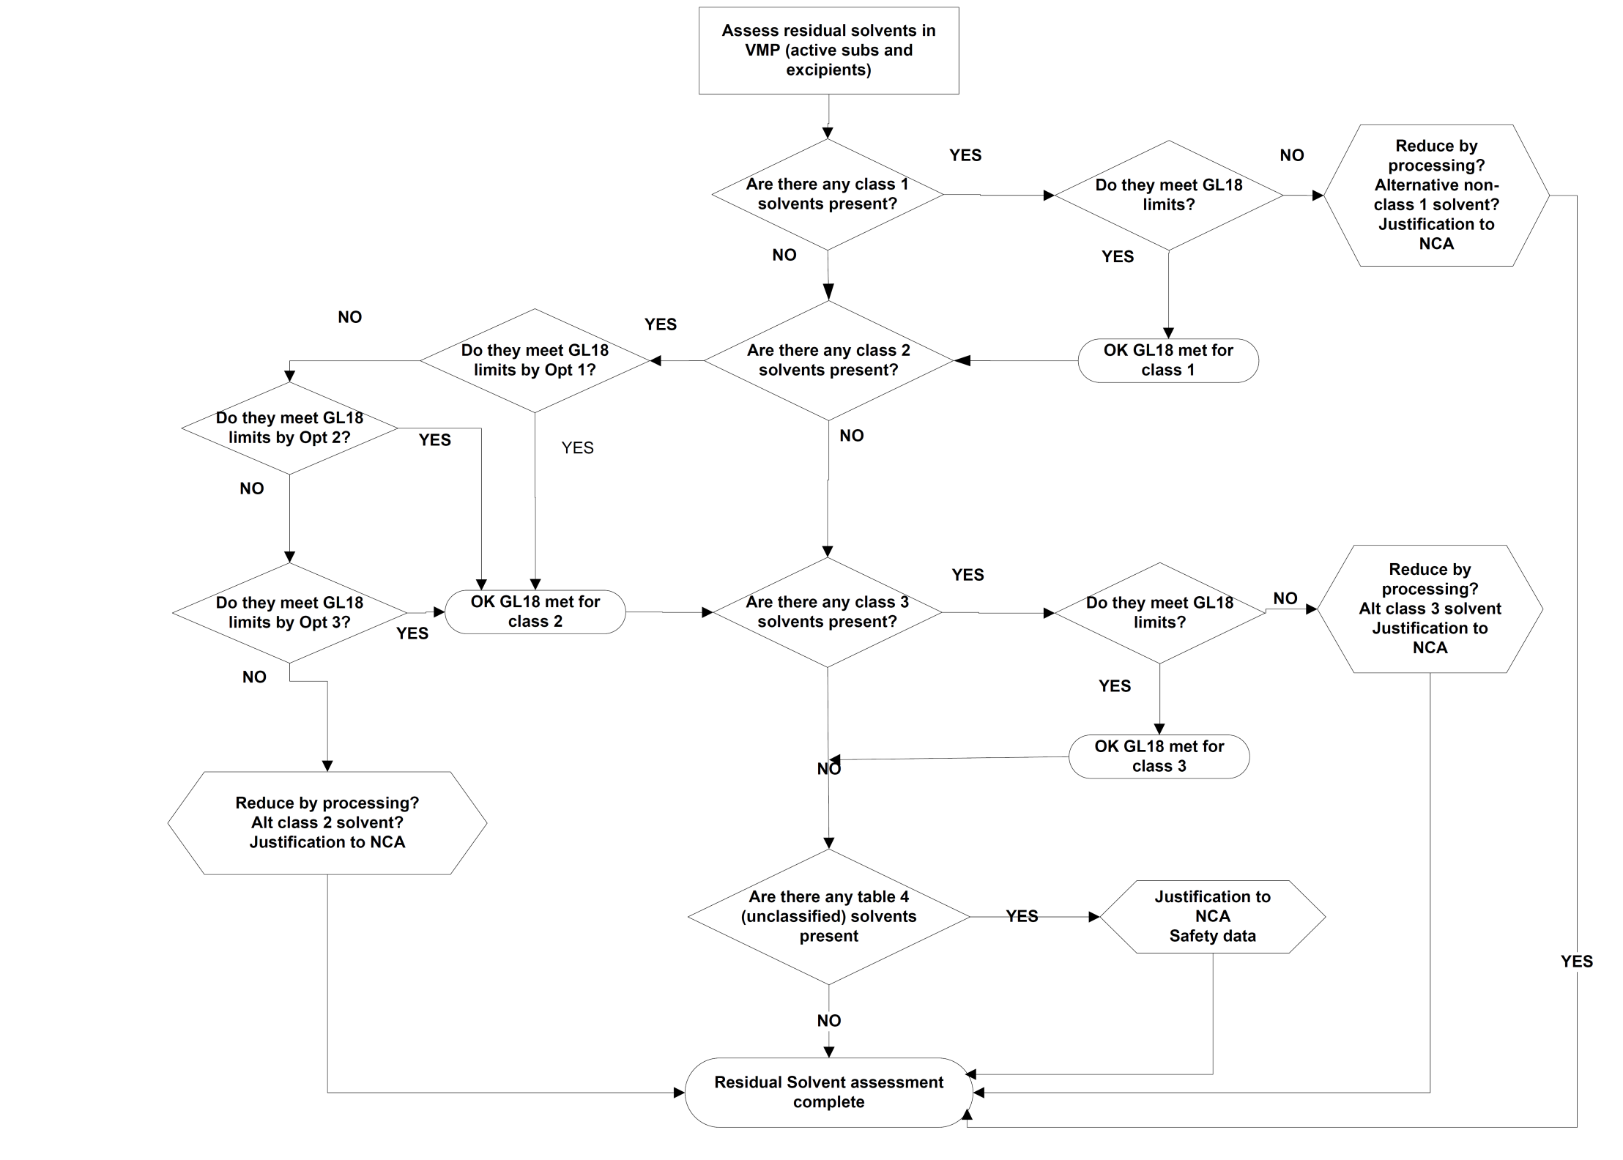
Flow chart for residual solvents assessment

