Slide 1
CVMP Strategy on Antimicrobials
Presented by David Murphy
Chair, Committee for Medicinal Products for Veterinary use (CVMP)

Slide 2
Content
The problem of antimicrobial resistance (AMR)
CVMP strategy on antimicrobials 2016-2020
Measures to reduce the need to use antimicrobials in animals
‘One health’

Slide 4
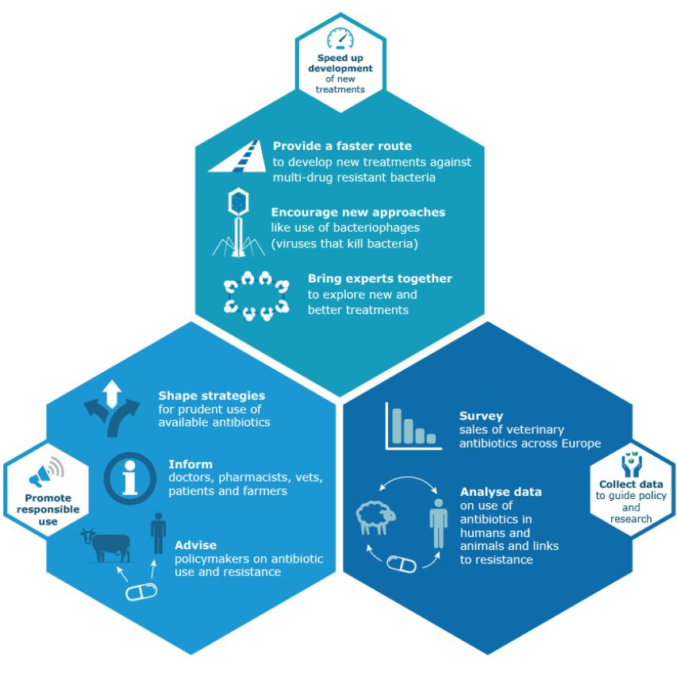
Agency role
support the development of new medicines and treatment approaches;
promote responsible use of existing antibiotics;
collect antimicrobial consumption data to guide policy and research.

Slide 5
Background: AMs for use in animals in the European Union
Antimicrobials heavily regulated:
Gradual phase out as growth promoters since 70’s, complete ban in 2006.
Antibiotics are prescription only.
Many MSs taking action to reduce antimicrobial consumption
New intended regulation of veterinary medicinal products will provide tools to tackle AMR specifically.
Committee of Medicinal Products for Veterinary Use (CVMP) strategy on antimicrobials in place since 1999.

Slide 6
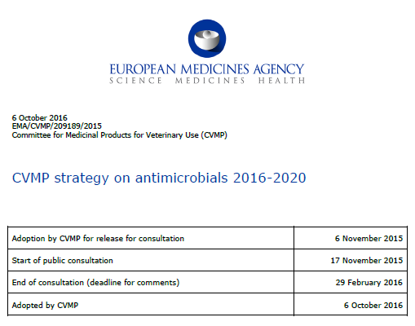
CVMP Vision Statement on antimicrobials 2016-2020
The CVMP’s vision is the availability of effective antimicrobial medicines for the treatment of important infectious diseases of animals with, at the same time, minimum risks to animals or humans arising from their use.

Slide 7
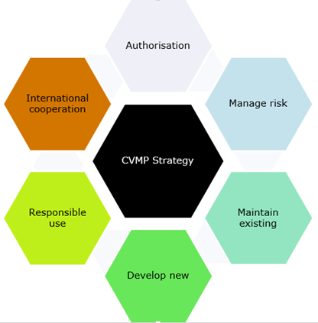
CVMP Strategy on antimicrobials 2016-2020
Builds on former strategies with an increased emphasis on activities of CVMP taking place within a wider EU and international context
Provides the necessary strategic framework within which all activities related to AMR carried out by EMA/CVMP should take place

Slide 8
Summary of the CVMP strategy
Aim 1: To provide opinions for the authorisation of effective antimicrobial veterinary medicinal products ensuring that the necessary risk management measures are applied so that products can be used safely and sustainably.
Aim 2: To consider and advise on the risk to public health that could arise from the use of antimicrobials due to the transfer of antimicrobial resistance from animals to humans, and to balance this against the need to protect animal health.

Slide 9
Summary of the CVMP strategy (cont.)
Aim 3: To maintain the effectiveness of antimicrobial substances that are already authorised in veterinary medicinal products by monitoring and analysing their sales and usage, encouraging surveillance for changes in susceptibility of target pathogens and zoonotic bacteria, and subsequently reviewing the authorisation of substances and/or products, especially when there is evidence that there may be a related change in the benefit-risk of the authorisation.
Aim 4: To encourage the development of new and existing antimicrobial veterinary medicinal products, especially in order to fill therapeutic gaps and for minor uses and minor species, and to foster the development of alternatives to antimicrobials.

Slide 10
Summary of the CVMP strategy (cont.)
Aim 5: To support the responsible use of antimicrobials both in accordance with Marketing Authorisations and when used outside the terms of the MA.
Aim 6: Recognising that AMR is a global problem affecting both animal and human health, to work in partnership with the European Commission, international regulatory bodies, human and animal health organisations and the pharmaceutical and livestock industries to provide science led guidance on the responsible use of antimicrobials in animals.

Slide 11
Other considerations of the strategy
One of the most effective measures to limit expansion of AMR is an overall reduction in antimicrobial use.
This is best achieved through measures to prevent infections from establishing (husbandry, biosecurity, vaccination, etc) and more targeted use of antimicrobials where it is still necessary to guard animal health (e.g. by use of accurate diagnosis, evidence-based regional treatment guidelines and correct dosing regimens)
The CVMP will also support the development of veterinary medicines which reduce the need for use of antimicrobials (“alternatives”), such as vaccines.

Slide 12
Measures to reduce the need to use antimicrobials in animal husbandry in the EU (RONAFA)
European Commission request to the EMA and EFSA
Review the measures that have been, or are being taken, to reduce the use of antimicrobials in animal husbandry in the EU.
Assess the impact of such measures regarding the occurrence of antimicrobial resistance in bacteria from food-producing animals and food.
Possible alternatives to the use of antimicrobials in animal husbandry in the EU.
Impact of such alternative measures on the occurrence of antimicrobial resistance
Recommend options to reduce antimicrobial usage in animal husbandry in the EU

Slide 13
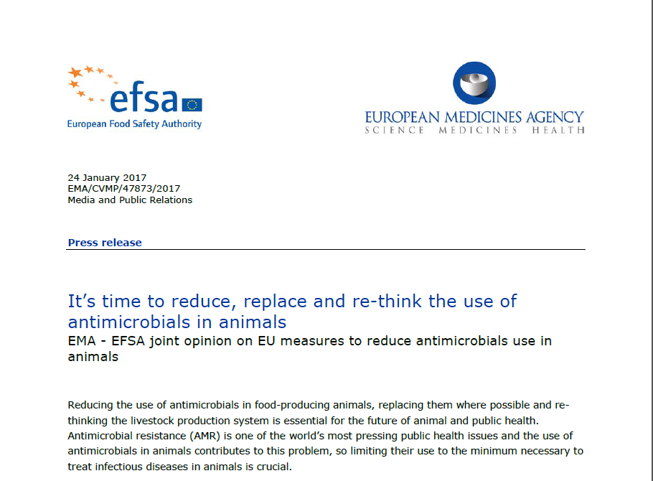

Slide 14
Recommendations to reduce antimicrobial use in food-producing animals
An integrated, multifaceted approach is needed:
Control strategies that have been important drivers for change include setting of national targets to reduce antimicrobial use.
Use should be reduced to the minimum that is necessary to treat infectious diseases…….their use to prevent such diseases should be phased out in favour of alternative measures.
CIAs for human medicine should only be used in animals as a last resort.
Consider alternatives to antimicrobials.
Implementing farming practices that prevent the introduction and spread of the disease.
Education and awareness.

Slide 15
Other considerations of the CVMP strategy
AMR is an expanding global problem affecting both animal and human health. Therefore it is important that the CVMP continues to work with colleagues in the EU network agencies, international regulatory bodies and with its stakeholders to ensure harmonisation of regulatory frameworks and that a One Health approach is taken to the control of AMR.
Collaborate with international bodies such as VICH and Codex to harmonise regulatory frameworks;
Participation at Transatlantic Taskforce on Antimicrobial Resistance (TATFAR)
Comments provided to the work of other international organisations as required (e.g. WHO, OIE).

Slide 16
“EMA supports a 'One Health' approach, promoting a close and integrated cooperation between the human and veterinary fields.”

Slide 17
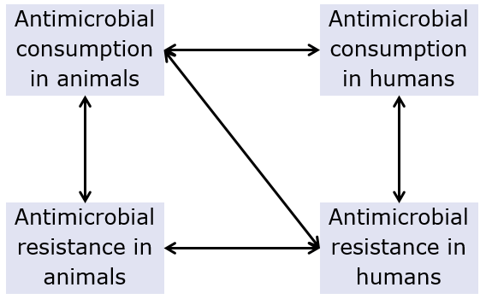
Joint Interagency Antimicrobial Consumption and Resistance Analysis (JIACRA) Report
Joint report on the integrated analysis of the consumption of antimicrobial agents and occurrence of antimicrobial resistance in bacteria from humans and food-producing animals (January 2015).
http://www.ema.europa.eu/docs/en_GB/document_library/Report/2015/01/WC500181485.pdf

Slide 18
Conclusions
Antimicrobials are a key tool for the treatment of infectious diseases in animals.
Focus is on ensuring availability of effective antimicrobial VMPs, while minimising risks to animal and public health associated with their use.
Key message: Reduce, Refine, and Re-think
Note recommendation for phasing out of preventive use of AMs
Generation of good quality data to guide policy and assess impact of measures is critical (human/vet collaboration is an important element of this).

Slide 19
Thank you for your attention
Further information
info@ema.europa.eu
European Medicines Agency
30 Churchill Place • Canary Wharf • London E14 5EU • United Kingdom
Telephone +44 (0)20 3660 6000 Facsimile +44 (0)20 3660 5555
Send a question via our website www.ema.europa.eu/contact
Follow us on @EMA_News

Slide 20
Back-up slides

Slide 21
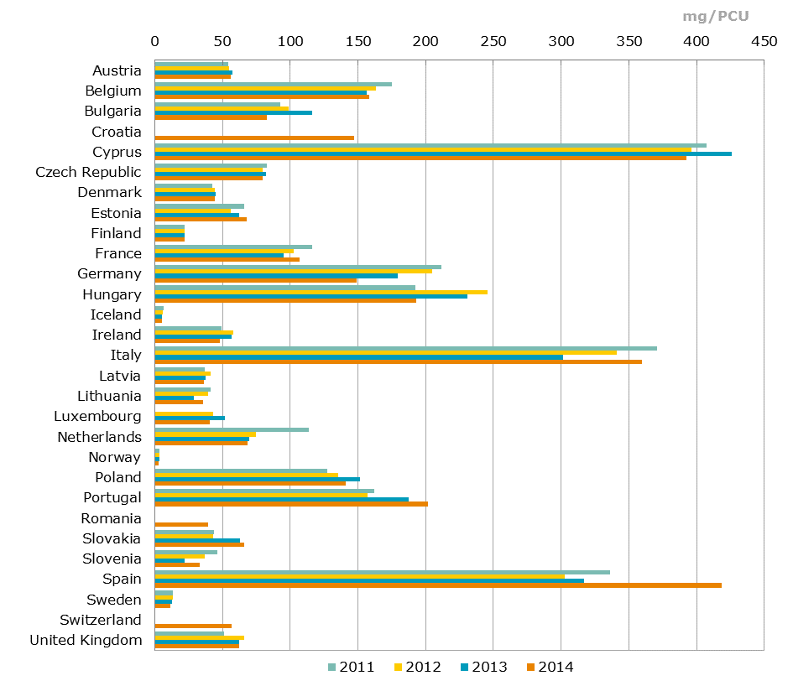
Total sales of veterinary antimicrobials agents for food-producing species, in mg/PCU, from 2011-2014, for 29 European countries PCU = sales corrected by the animal population (kg biomass at time of treatment).

Slide 22
Antimicrobial use in animals in the European Union EMA ESVAC (2016)
Large variation in the sales of antimicrobials across MSs, ranging from 3.1 to 418.8 mg/PCU;
91.6% of overall sales were for oral administrations (group treatment), with 42.1% of sales as premixes;
Most frequently used antimicrobials were tetracyclines (33.4%), penicillins (25.5%) and sulfonamides (11.0%);
Of the CIAs, polymyxins (mostly colistin) account for 6.6% of sales, fluoroquinolones for 1.9%, and 3rd-and 4th-generation cephalosporins for 0.2%;
For 24 countries reporting sales data to ESVAC for the years 2011–2014, an overall decrease of 12% in sales (mg/PCU) was observed.

Slide 23
Antimicrobial use in animals in the European Union EMA ESVAC (2016)
Prescribing patterns of the various antimicrobial classes, expressed as mg/PCU, varied substantially between countries.
3rd- and 4th-generation cephalosporins, ranging from 0.01 % to 1.5 % of sales
Fluoroquinolones, 0.01 % to 11.9 % and
Macrolides, 0 % to 16.9 %
Polymyxins, 0 % to 8.7 %

Slide 24
Use of colistin in animals and CVMP actions
In animal medicine colistin is mostly used for the treatment of enteric diseases in e.g. pigs and poultry.
CVMP has concluded referrals restricting its use to treatment and metaphylaxis.
Combinations of colistin + another AM - prohibited.

Slide 25
Colistin - actions
Reduction of use of colistin below 5 mg/PCU
Ideal target; below 1 mg/kg PCU
No increase in use of fluoroquinolones or 3rd and 4th generation cephalosporins
No increase in overall antimicrobial use
ESVAC data allows for targeted objectives.
European countries and European Commission to take action

Slide 26
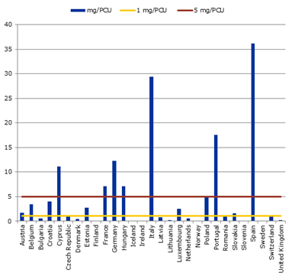
Colistin – mg/PCU
Sales of colistin in for use in animals in mg/PCU in 2013 (ESVAC data), including the 5 and 1 mg/PCU levels. No sales reported in Finland, Iceland and Norway.
66% and 93% of reduction respectively.

