Slide 1
Trilateral Assessment of Metacam for Use in Sheep
New Zealand, Australia & Canada

Slide 2
3 Countries – 104.8 million sheep & lambs
4.5 million people
27.5 million sheep
23.1 million people
74.0 million sheep
Canada
35.2 million people
.8 million sheep
New Zealand
Australia

Slide 3
Prudent to Use Collective Resources Metacam for Pain Management in Sheep
Canadian Sheep Producers wanted product to manage pain – good animal welfare practice
All 3 authorities used the Australian Boehringer Ingelheim submission
Boehringer Ingelheim Australia was the project lead & main contact
Approached by Veterinary Drugs Directorate, Health Canada to see if they would be interested in a trilateral review for Metacam. Recognized that there would be limited sales but animal welfare benefits to the species & producers.

Slide 4
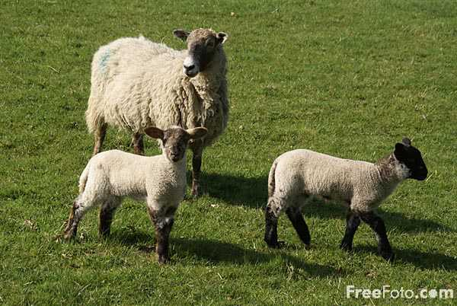
Positives of a Tri-lateral Review
Best use of company human & financial interests – generally
same questions from each regulator which helped companies manage
responses & reduce workload.
Small market like Canada - limited business interest in bringing product to the market place yet animal welfare & producer benefits
Regulatory fees of $30,500 Canadian
Regulatory agencies able to jointly review Australian submission & share expertise –
workload for each regulatory agency was reduced as they only had 1 data module each to assess &
provided an opportunity for the regulators to meet, discuss the application and assessment processes.
1 product: 3 shared reviews: 3 joint approvals basically at the same time

Slide 5
Boehringer Ingelheim & other pharmaceutical companies would consider trilateral and bilateral reviews should the opportunity arise

