Slide 1
VICH Public Conference 6: February 2019 INVITATION TO VOF MEMBERS
DR A T SIGOBODHLA
01 MARCH 2017

Slide 2
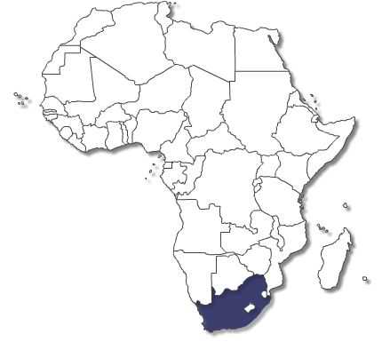
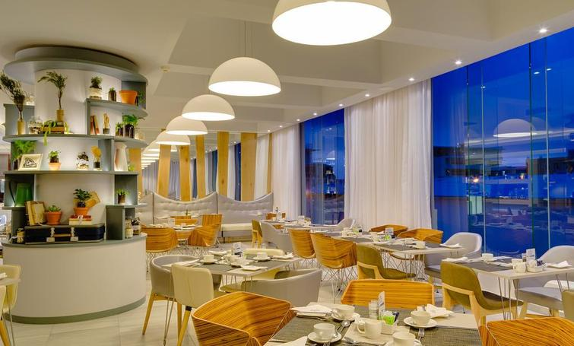
LOCATION
Protea Fire and Ice Hotel by Mariott
New Church St, Tamboerskloof, Cape Town, 8001 Tel: +27 21 488 2555

Slide 3
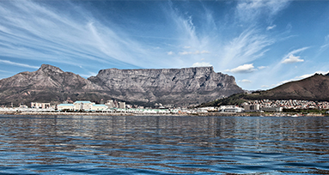
THEME: “GETTING IT TOGETHER IN AFRICA”
About Republic of South Africa
South Africa is 1 233 404 km² in size and is edged on three sides by nearly 3 000 km of coastline, with the Indian Ocean to the east and the Atlantic Ocean to the west.
South Africa has three capitals, nine provinces and eleven official languages.
The VICH 6 Conference will be held in Cape Town, South Africa’s “Mother City”.
Cape Town is home to the world famous Table Mountain and Robben Island.
With an international airport and busy port, the city is a bustling metropolis that is particularly popular with international travellers for its cultural mix, urban sophistication and stunning scenery.

Slide 4
DRAFT PROGRAMME
Draft Programme
VICH meeting before and after the Conference: group photo and industry exhibitions
VOF meeting before the Conference: Group photo and evening Welcome reception
Conference: 5 sessions and research abstracts & posters in the pause area from the officials in the regulatory authorities
Welcome reception to all delegates: Night before the Conference
Gala Dinner: Day 1 of Conference: African cuisine, music and dance

Slide 5
PROPOSED AGENDA TOPICS
9 SESSIONS
Session 3: How to use VICH guidelines
Session 5: Contribution to animal welfare: One Health Approach? AMR? Residue monitoring? Research?
Session 7: Topics of particular interest for Observer Countries and VOF Members
Session 8: Ongoing Activities: Global Perspectives:

Slide 6
WEBSITE: HOME PAGE
Home Programme SC meetings Outreach Forum sessions Venue Proposed accommodation Registration Exhibitions Travel information Airport transfers Tours
“GETTING IT TOGETHER IN AFRICA” COUNT DOWN TIMER
6th International Cooperation on Harmonisation of Technical Requirements for Registration of Veterinary Medicinal Products (VICH) Conference
Cape Town, South Africa, February 2019

Slide 7
INVITATION PAGE
TO THE VICH 6 CONFERENCE
The South African National Department of Health and the National Department of Agriculture are pleased to invite you to the magnificent city of Cape Town, to join us for the VICH 6 Public Conference. The open post VICH meeting Conference event, entitled "Getting it together in Africa" will be convened from 6-7 February 2019 at the Cape Town Protea Fire and Ice Hotel, South Africa. To register click here.
Contact Us
General conference enquiries can be directed to:
Ms Kelly Klaus at: kklaus@ahi.org
Dr Hervé Marion at: sec@vichsec.org
Dr Alice T Sigobodhla at: sigobA@health.gov.za
Mr Ernest Schay at: ernest.schay@bayer.com
We look forward to welcoming you in Cape Town, South Africa.

Slide 8
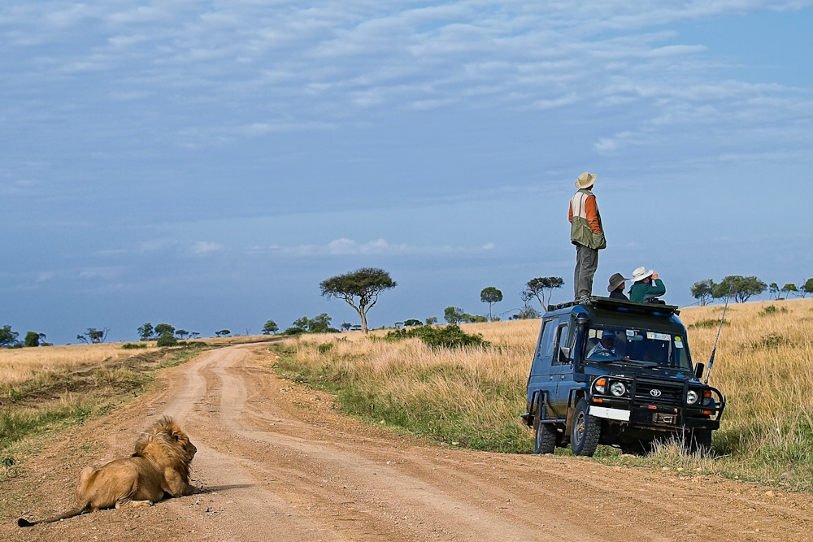
THANK YOU you
About 80% of antibiotics are used in agriculture: 69% are in feed medication
The number of effective antimicrobials available for use is decreasing
The upward trend in antimicrobial resistance: a global concern
Resistance even exists in the newer groups of antimicrobials.
Colistin is the last resort drug for human use
?Restricted/withdrawal of critically important drugs from veterinary use
? Continued S 21 requests for human use

