Slide 1
Report by the VICH Steering Committee on issues raised by Forum members during the 8th Outreach Forum meeting
Hervé Marion, DVM VICH Secretariat
9th VICH Outreach Forum Meeting
Tokyo, 14-15 March 2017

Slide 2
Group discussions
8th Forum: Usefulness of breakout in small group discussions with VOF and SC members
Extension of time for group discussions
Day 1: Breakout session 1 = Small groups
Day 2: Breakout session 2 = General tour de table discussion

Slide 3
Group discussions
8th Forum: Individual VICH Outreach Forum member questions
Breakout session 1 (Tuesday from 14.30 to 17.15)
Regional organisation and collaborating systems (Presentations by CAMEVET and ASEAN)
VICH SC and observers experience - The EU organisation in place
Discussion on how to develop Regional organisation and collaborating systems

Slide 4
Group discussions
Breakout session 2 (Wednesday from 09.00 to10.30)
Pharmacovigilance (Introduction by the FDA)
Tour de table open discussion & questions on:
Needs of the VOF members
Global electronic systems
Sharing the Pharmacovigilance data

Slide 5
Proposed new topics
Report from SC discussions on proposed new topics from VOF
AMR – how VICH GL 27 is used in Japan - surveillance connected to efficacy
Alternatives to Antimicrobial: processes for regulation to control autogenous vaccine in Thailand

Slide 6
Specific Issues
8th Forum: Specific issues
Vaccines (USDA)
Vaccines stability
Immunogenicity studies
Biologicals (JMAFF)
Review of the VICH GLs on Biologicals

Slide 7
Specific Issues
New VOF members Registration systems
Nigeria
Zimbabwe
Feed-back of the training Workshops held in Brunei

Slide 8
VOF participation in EWGs
New EWG for combination product GLs
Chaired by China – Dr Xu
Expert from Argentina
VOF experts are also participating in the development of:
MRK GL: Residues in Honey (Argentina)
Quality GL: Stability Testing of New Veterinary Drug Substances and Medicinal Products in Climatic Zones III and IV (Camevet, China & Morocco)

Slide 9
VOF meetings freqency
VICH SC members ongoing reflexion
Current meeting frequency = 9 months
New proposal:
12 months’ cycle for VICH SC and VOF meetings

Slide 10
Next Public Event
VICH 6 CONFERENCE
GETTING IT TOGETHER IN AFRICA
CAPE Town, SA
27 & 28 February 2019

Slide 11
VICH website
Outreach Forum members only webpage
(http://www.vichsec.org)

Slide 12
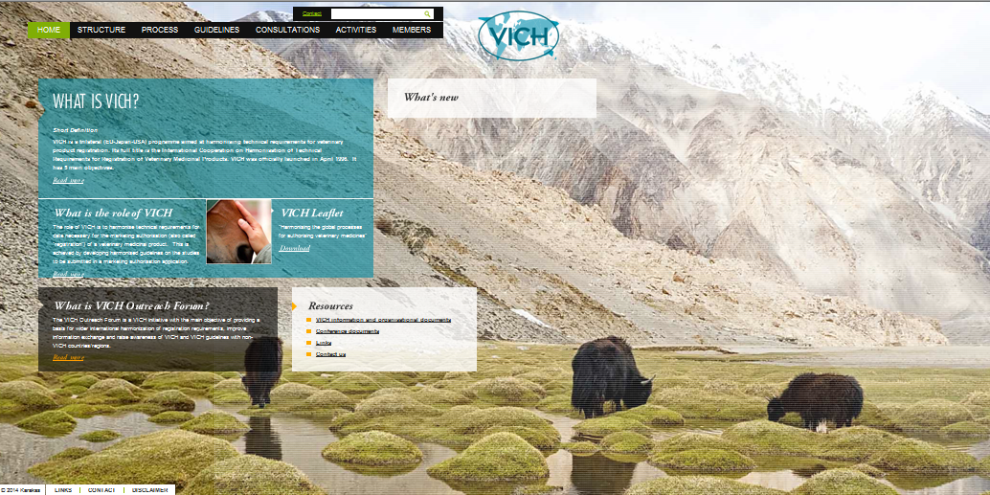
The VICH public website (http://www.vichsec.org)
12
Notes:
12

Slide 13
THANK YOU FOR YOUR ATTENTION !

